Slide 1
Efficient Graph Analytics on Real World Graphs
Joana M. F. da Trindade
jmf@csail.mit.edu
Notes:
Welcome to my defense, I’m Joana, and today I’m here to talk to you about the work I’ve done for efficient graph analytics on real world graphs

Slide 2
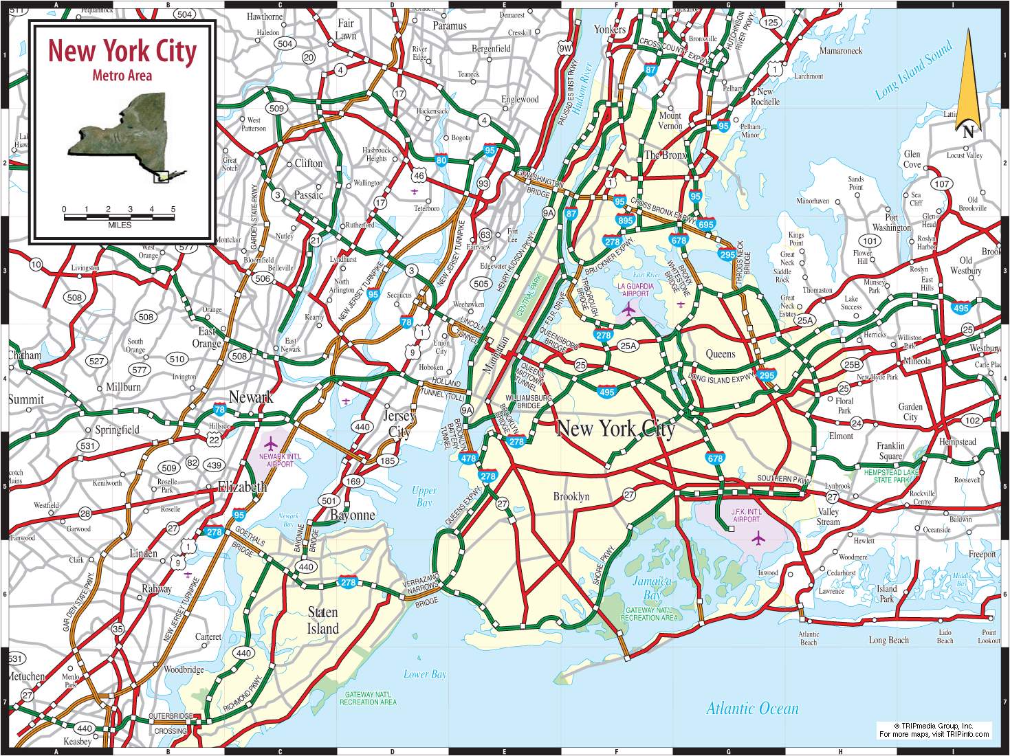
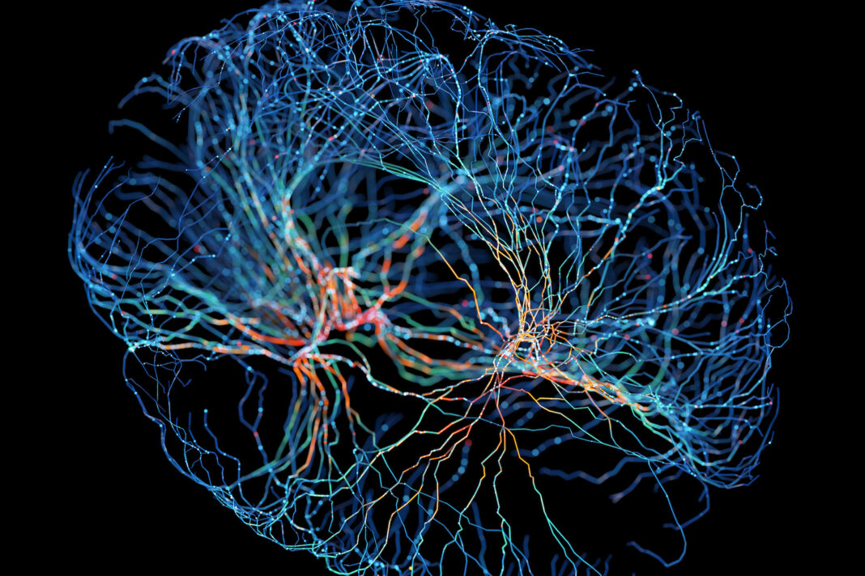
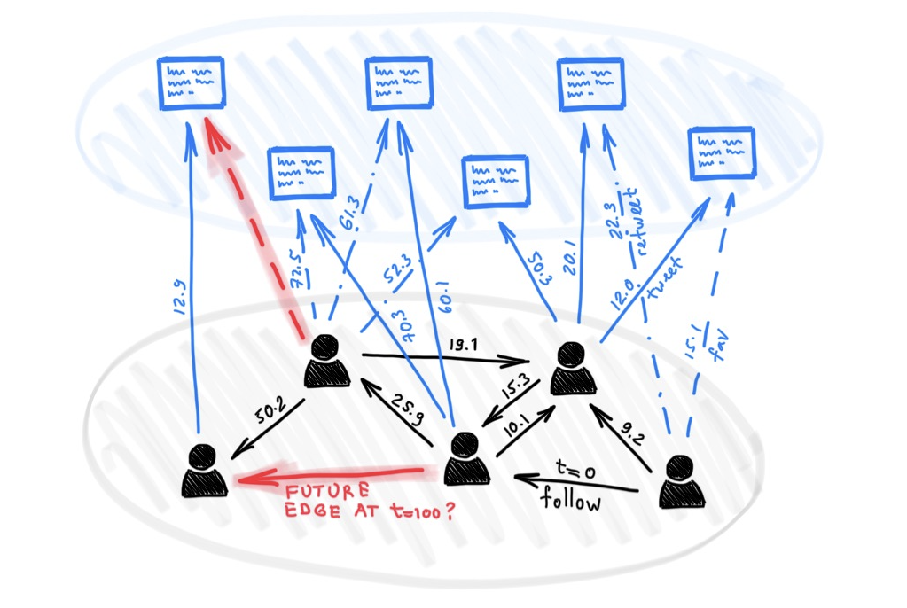
“Graphs are everywhere” they say
www.tripinfo.com/maps/ny-new-york-city
“Brain Network Mapping Study Challenges Basis for
Psychiatric Distinctions” (genengnews.com)
e.g.,
- hyperlink 2012: 128B edges
- MSFT data infra: 16B edges / week
“Deep learning on dynamic graphs” (blog.twitter.com)
Notes:
Virtually every talk on graph data processing or graph databases starts with the classic “graphs are everywhere” slide. Depending on the target audience, the title of the slide will use the term “networks” instead of ‘graphs”, and in this talk I’ll use them interchangeably.
And it’s true, there are a number of domains in which data is naturally represented as graphs, as this data model offers a way to represent entities and their relationships.
For example, on the upper left we have a road network for NYC metro area; on the upper right, we have a brain network, in which vertices are neurons (about 100B of those in the human brain), and edges are the connections between them.
A less traditional example, and one I’m rather fond of, is a graph learning task in which the goal is to predict whether an edge may exist on the underlying graph at a future point in time.
I’m also showing on the bottom left some example graph data sizes. The second one refers to the number of edges on a data lineage graph I’ve analyzed at a Microsoft production cluster, and in which I'll focus for a good part of this talk.

Slide 3
Cloud computing companies extract large graphs from production systems logs every day
Queries include:
- k-hop paths (dependency analysis)
- subgraph traversals
- temporal paths
Graphs are large and skewed:
- billions of edges every week
- both degree and temporal skew
[1] R. Mavlyutov, C. Curino, B. Asipov, P. Cudre-Maroux, Dependency-Driven Analytics: A Compass for Uncharted Data Oceans. CIDR 2017
Notes:
So folks at Microsoft -- and other large cloud service providers -- are really interested in this class of machine generated graphs that reflect workloads produced by big data processing systems. Every time a task or job consumes or outputs data artifacts (such as files), these events are recorded and added to what is referred to as a data lineage graph.
Just in like in the other example graphs I showed before, there are number of interesting queries that can be asked of these graphs. Most often, they take the form of dependency chains, such as anchored k-hop paths, and subgraph traversals.
If the graph data captures interactions that are valid at some point, or interval in time, then the queries may also include temporal variations of these graph traversals.

Slide 4
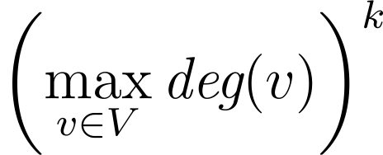
Problem: on large graphs, k-hop path queries can be expensive even for small values of k
Worst-case complexity
is proportional to:
k=1
k=1
k=2
k=2
…
…
…
…
k=3
…
…
…
Weekly data lineage graph of Microsoft production cluster had 3.2 Billion vertices,
16.4 Billion edges, and on-disk footprint of 10+ Terabytes.
Notes:
On these large graphs, even relatively simple k-hop query traversals can be expensive. How expensive? The distributed relational engine that we used at Microsoft to try and answer such queries over that data lineage graph took hours to do so, even for small values of k.
Tthere are a number of reasons for this, and one of the key ones is that, in the worst case, their complexity is determined by the maximum vertex degree you have in the network, to the power of k.
[NEXT SLIDE]

Slide 5
Problem: on large graphs, k-hop path queries can be expensive even for small values of k
Distributed relational engine at Microsoft took hours to answer it
Real-world graphs are skewed; relational engines produce inefficient plans (recursive self-joins)
Existing graph databases limited in performance
Distributed engines (e.g., Pregel and Flink) incur lots of messaging overhead
To be used for operational decisions, these queries require short response times (seconds to mins)
Notes:
Now, folks in the audience that are experienced with relational query engines, might be tempted to represent this data using a vertex table, and an edge table. They might then want to pose this query as sequence of recursive self-joins. Well, we tried a highly optimized version of that back then, but the problem then gets exacerbated: relational engines will materialize intermediate data (such as cartesian products of the edge table) for each of those hops. And then the data sizes quickly explode.
There are some techniques to alleviate this, such as n-way joins, but it still does not fully solve the problem.

Slide 6
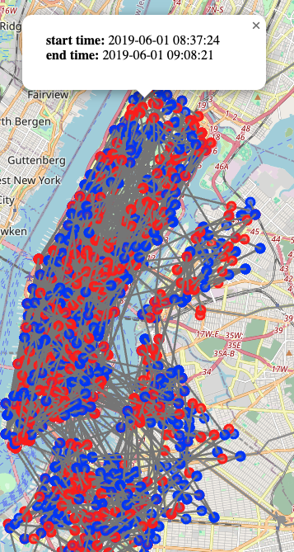
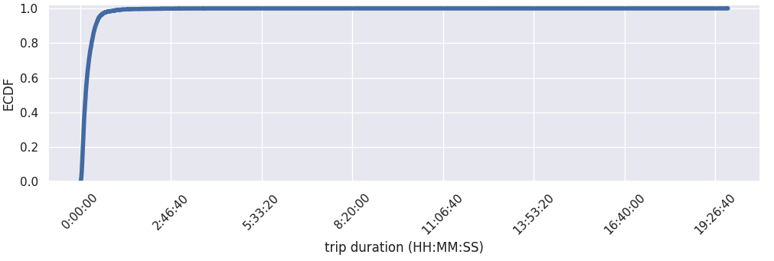
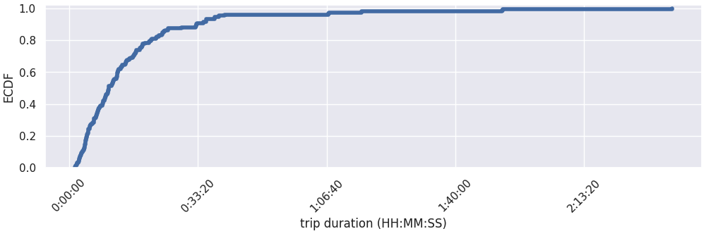
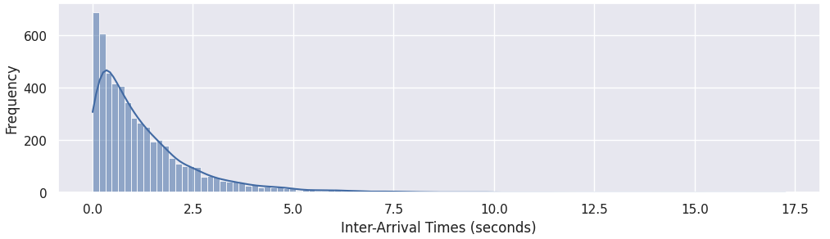
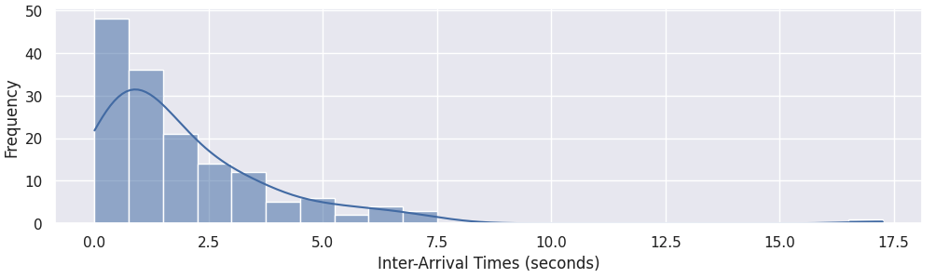
Problem: one size does not fit all
Trip start time: [8am, 10am]
CitiBike NYC trips data (plots + viz at https://github.com/jmftrindade/citibike_analysis)
Notes:
To make things worse, with the exception of road networks, pretty much every real-world graph is skewed in multiple dimensions.
As an example, on the left we have a subset of bike trips in NYC that start between a certain interval in time (8am to 10am), but the interval itself doesn’t matter that much. The takeaway from here is that, in the case of temporal graphs, you have even more sources of skew – the more you increase the interval in question, the higher that skew gets.
[NEXT SLIDE]

Slide 7
Problem: one size does not fit all
Real-world graph data is skewed in several dimensions
Degree skew: caused by preferential attachment (“rich get richer”)
Temporal skew: human generated event durations and IAT follow power-law
Graph query optimizers treat every vertex the same
Assume i.i.d. and/or fail to capture temporal correlations
Temporal graph data offers crucial insights, yet remains unexplored
How can we leverage temporal dynamics for query optimization?
Notes:
And this is because temporal dynamics (such as inter-arrival times and event durations) for many human generated processes is log-normally distributed, or in other words, yields some form of a power-law.
This is known to cause issues with query optimizers, who produce inefficient plans as they often assume independent and identically distributed random variables when estimating cardinalities. In the case of highly-skewed data, this leads to incorrect estimations.
Temporal graph data poses additional challenges, yet at the same time, because there are so many interesting correlations in human activity, it also presents an incredibly underutilized opportunity. The question then is, how can we extract and use this information to produce better plans for graph query optimization?

Slide 8
Key Contributions of this Thesis
How can we speed up expensive graph queries (e.g., k-hop)?
Introduce class of sparser graph views
Infer materialized graph views that are beneficial for queries
Rewrite queries in terms of those views
How can we leverage temporal dynamics for query optimization?
Memory-efficient data representations for temporal graphs
Selective Indexing: treat large vertices differently than others
Leverage the above to implement efficient algorithms over temporal graphs
Notes:
So here are my contributions to help answer these two key questions.
The first one: how we can speed up execution for this class of expensive tasks that are often part of graph query workloads? To this end, I introduced a set of techniques that essentially identifies materialized views (or in other words, precomputed query results) that can be beneficial to the queries, and then we can rewrite the queries in terms of those views.
For the second question: how can we extract these temporal dynamics, or otherwise interesting correlations from real-world graph data, so that we can use them to improve query processing? Together with that, what is the most efficient way in which can process these temporal graphs? And how can we do that for the class of queries and algorithms that are often used in these temporal graph analytics contexts? My contributions here started from first principles, going all the way to efficient data representations for these temporal graphs that can be used with state-of-the-art parallel graph processing systems. In addition, I proposed a method for using these temporal data correlations for query optimization, which enable optimizer to give the special treatment to these really large vertices that they deserve.

Slide 9
Thesis Outline
Kaskade: Graph Views for Efficient Graph Analytics
J M F da Trindade, K Karanasos, C Curino, S Madden, J Shun
ICDE 2020
Kairos: Efficient Temporal Graph Analytics on a Single Machine
J M F da Trindade, J Shun, S Madden, N Tatbul
Under submission to VLDB 2024
Notes:
So with that, here is the outline for my thesis and this talk:
I present two distinct systems tailored for optimizing queries over large real-world graphs. The first one, Kaskade [5], targets the challenges of efficient query evaluation by leveraging structural properties of graphs and queries to infer materialized graph views.
The second system, Kairos [6], which focuses on the challenges that are introduced by temporal data settings, as I mentioned in the previous slide.
I will start with Kaskade [NEXT SLIDE], and then I will finish with Kairos.

Slide 10
Kaskade: Key Technical Contributions
Graph views
Sparser views such as connectors and summarizers (e.g., filters and aggregates)
Constraint-based view enumeration
Mine constraints from graph’s schema and data’s structural properties
Rewrite queries in terms of beneficial views
Cost model for graph views
View size estimation leverages structural properties
Only most beneficial views are materialized
Notes:
[JUST READ THE SLIDE]
First, we identify and introduce a class of graph views that are beneficial for query processing.
Second, we introduce a technique for constraining the space of possible views to enumerate.
Finally, we establish a cost model for deciding which views are beneficial to materialize and use for query rewriting. [NEXT SLIDE]

Slide 11
Kaskade: Key Technical Contributions
Graph views
Sparser views such as connectors and summarizers (e.g., filters and aggregates)
Constraint-based view enumeration
Mine constraints from graph’s schema and data’s structural properties
Rewrite queries in terms of beneficial views
Cost model for graph views
View size estimation leverages structural properties
Only most beneficial views are materialized
see thesis for details
Notes:
In this talk, I will not go into too many details on the cost model we introduced in Kaskade, but you can check out my thesis for that.

Slide 12
What is the Graph Data Model in Databases?
Schema defines types of vertices and edges.
Each vertex or edge type has a name, and a set of attributes.
Vertex Types:
Edge Types:
Job
is_read_by
attrs.: {“id”, “start time”, “status”, …}
attrs.: {“start time”, “end time”, “bytes read”, …}
File
writes_to
attrs.: {“location”, “size”, “last updated”, …}
attrs.: {“start time”, “end time”, “bytes written”, …}
Notes:
A key aspect that we explored in Kaskade is this notion of “regularity”, meaning, the fact that real-world graphs are a lot more structured than a generic vertex-and-edge data model would suggest. In part, this regularity is represented in the notion of a graph schema.
A graph schema defines the types of entities (vertices and edges) in the graph and how they related to one another. Each vertex or edge type has a name and a set of attributes (properties) associated with it.
As I mentioned before, data lineage graphs are used in cloud computing companies to record where data came from in a datacenter. So here is an example schema for those lineage graphs. [NEXT ARROW]
Here we have two types of vertices Jobs and files, and two types of edges [NEXT ARROW]
Notice how these entities can a number of attributes. In particular, that data lineage graph was temporal, in that the edges it recorded captured events that had both a start and an end time (meaning, the event was valid during an interval in time).

Slide 13
What is a Graph Query?
Q1: “Which files has Job1 written to?”
Q3: “Which jobs may have indirectly consumed data from File1?”
Q2: “Which jobs have read File1?”
Q4: “Which jobs depend on Job1?”
k-hop path queries
Notes:
We talked at a high level about graph queries, but what are some concrete examples. We can of course ask immediate 1-hop neighborhood questions, such as Q1 and Q2. And relational folks in the audience are already thinking of a small join to do this, which would definitely work.
However the more commonly used graph queries take the shape of subgraph traversals that are interested in understanding these sort of long chain of dependencies in the underlying data set. [PRESS ARROW]
These, however, as we’ve already seen, would not be answered efficiently with relational engines, and we focus on optimizing them.

Slide 14
What is a Graph View?
V1: “Which files has Job1 written to?”
V2: “Which jobs depend on Job1?”
Notes:
In Kaskade we introduce a class of graph views that help with query optimization.
And more concretely, a Graph View is also a Graph, and is defined by a Graph Query. It can be pre-computed or obtained on demand. Views are typically created (or materialized) offline. Notice that V2 here is showing pair-wise data flow dependencies between pairs of jobs there.

Slide 15
Key Insight: exploit regular structure in graphs to improve query performance
writes_to
Job
File
is_read_by
Schema for data lineage graph.
Schema dictates regularity: can use it to infer smaller graph views.
Notes:
Given all of that, a key insight that guided most of the ideas we introduce in Kaskade is this notion of regularity, and what do we mean by that?
The schema for a graph is also a graph. The cool thing about this is that we can use walks in this graph to enumerate instances of graph view schemas. [NEXT SLIDE]

Slide 16
Key Insight: exploit regular structure in graphs to improve query performance
writes_to
Job
File
is_read_by
Schema for data lineage graph.
Schema dictates regularity: can use it to infer smaller graph views.
Statistic | Example
Cardinality | No. vertices per Type No. edges per type
Degree Distribution | Max out-deg per vertex type Median out-deg per vertex type
Graph data statistics tell us when these views have a lot fewer vertices and edges, leading to much faster queries.
Example graph data statistics
Notes:
Furthermore, degree distributions and cardinalities for these different types of edges and vertices are fairly predictable. We can use that information to establish that dependency chains follow a fixed sequence, and we can use that for query optimization.
For example, if all I want to know is jobs that are related to other jobs, if i had precomputed this job to job graph, you can answer the job dependency query much more quickly without traversing files by creating a view over just the jobs
Specifically, we can rewrite queries in terms of sparser graph views that we can estimate to be beneficial for multiple queries in the workload, and that are correct by construction.

Slide 17
Problem Statement
Inputs
Graph queries
Graph schema
Graph data statistics
Goals
Find graph views that can be used to answer queries more efficiently.
Translate original queries to equivalent version (query rewriting).
Notes:
The problem statement then becomes, given input queries, schema, and structural properties (e.g., degree distributions, and type cardinalities), we’d like to find graph views that correctly answer an equivalent query more efficiently.
Specifically, the notion of efficiency we have in mind here is both in terms of query execution and view storage.

Slide 18
Kaskade: Graph Views for Efficient Graph Analytics
Notes:
[PAUSE FOR QUESTIONS]

Slide 19
Graph view example: 2-hop connectors on data lineage graph
Notes:
Now, the graph view that we hinted at earlier in the blast radius running example is a “2-hop connector”. Here we show how to obtain such “2-hop connectors” from a graph that follows the same schema as that of the data lineage graph at Microsoft. We have jobs in blue, files in gray, [NEXT SLIDE]

Slide 20
Graph view example: 2-hop connectors on data lineage graph
Notes:
Next, the 2-hop job edges are obtained by an operation that contracts directed k-length paths of size two. Each contracted path is now an edge on the corresponding 2-hop view. In this example, there are four such possible edges. [NEXT SLIDE]

Slide 21
Graph view example: 2-hop connectors on data lineage graph
Notes:
And then finally, this process yields two possible views, each of is a graph view that we can pre-compute for later use.

Slide 22
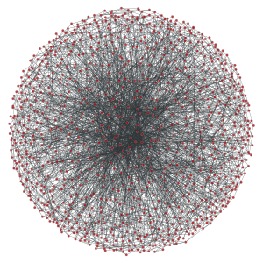
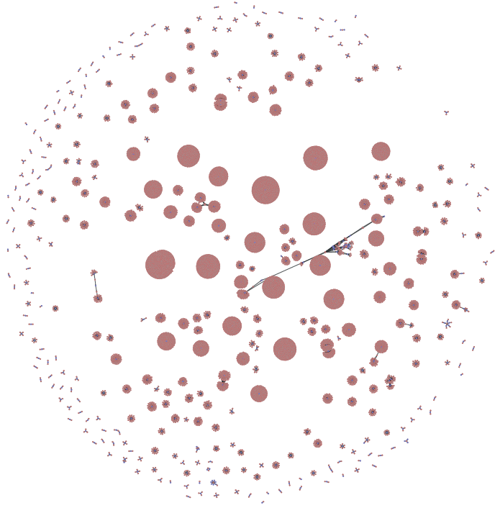
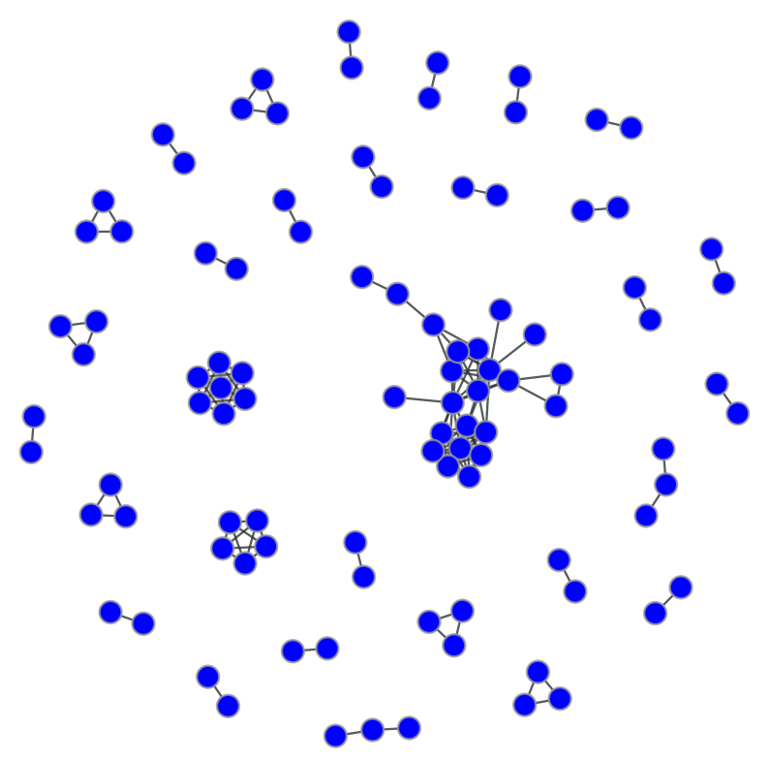
Example: input data size reduction when using graph views to answer “blast radius” query
Graph view
Graph view
raw graph
job-file graph
job-job graph
Size:
O(B) vertices
O(B) edges
O(TB) on disk
Size:
O(M) vertices
O(M) edges
O(GB) on disk
Size:
O(K) vertices
O(K) edges
O(MB) on disk
Notes:
And for that running example of a “job-blast radius” query, which can be answered from a job-to-job lineage dependency graph, then we’re talking about order of magnitude reduction, with a significantly smaller footprint on disk.

Slide 23
Kaskade: Graph Views for Efficient Graph Analytics
Notes:
Kaskade is an interesting system, in that it is not the graph processing engine itself, but rather a “query optimization framework”. What do I mean by that, here’s an overview of Kaskade, the system. I’ll show in more details one of its key techniques, but I find it helps to contextualize a little better if we look at it from this angle.

Slide 24
Kaskade: a system for graph query optimization using graph views
Offline: analysis of historical query workload
Notes:
First, based on historical query workloads, Kaskade identifies views that are beneficial for the query, and this done offline. [NEXT]

Slide 25
Kaskade: a system for graph query optimization using graph views
Offline: create / store views
that are beneficial for the queries
Notes:
Another aspect that Kaskade does offline is view management tasks, such as creating and storing views that it deems beneficial for the queries in the historical workload.

Slide 26
Kaskade: a system for graph query optimization using graph views
At runtime, execute rewritten
query over appropriate view
Notes:
Finally, at runtime, Kaskade then executes a rewritten version of the query over the appropriate candidate view.

Slide 27
Key contribution: exploit graph regularity to find efficient views for faster query execution
Graph view templates define the possible views we consider
Constraints are
regular patterns imposed by the graph’s schema (a graph)
regular patterns imposed by the query (a graph)
Constraint-based view enumeration
exploits regularity on graph’s schema and data’s structural properties.
finds views that can correctly answer queries.
rewrites queries in terms of these views.
Notes:
To make this idea of regularity more concrete, I need to tell you about these three things. The first one, is this notion of graph view templates, which are these declarative programs using first-order logic that can be used to enumerate views. [NEXT SLIDE]

Slide 28
Graph view templates define the possible views we consider
Concrete 2-hop connector views
are instantiations of
k-hop connector view template.
View template: kHopConnector(X, Y, XTYPE, YTYPE, K) with X=Y
Notes:
What is a view template? It is both a program to enumerate views, as well as an abstract definition of what shape (or schema) a class of candidate views can take. It helps to understand by looking at it bottom up. [NEXT SLIDE]
Concreate 2-hop connector views are instances of [NEXT SLIDE] specific schemas that describe the relationship between types of vertices, which themselves are instances of [NEXT SLIDE] an abstract k-hop graph view template.
At the bottom there, what I'm showing is the actual head of the corresponding logic rule in Prolog that defines how to enumerate such abstract classes of views.

Slide 29
Key contribution: exploit graph regularity to find efficient views for faster query execution
Graph view templates define the possible views we consider
Constraints are
regular patterns imposed by the graph’s schema (a graph)
regular patterns imposed by the query (a graph)
Constraint-based view enumeration
exploits regularity on graph’s schema and data’s structural properties.
finds views that can correctly answer queries.
rewrites queries in terms of these views.
Notes:
Now that we briefly introduced the notion of graph view templates, we can talk about what are constraints in this setting [NEXT SLIDE], and how they are used together with abstract view template definitions.
Essentially, constraints are logical facts (or axioms) that Kaskade extracts from regular patterns it observes in both the schema graph and the input query graph. This is best understood with an example.

Slide 30
Constraints are regular patterns imposed by the graph’s schema and query
Schema is a graph which imposes constraints on what views can be enumerated.
Query is a graph which imposes constraints on what views can be enumerated.
writes_to
Job
File
is_read_by
Schema for data lineage graph.
MATCH (j1:Job)->(f1:File)
(f1:File)-[r*0..k]->(f2:File)
(f2:File)->(j2:Job)
RETURN j1, j2
Pattern matches all jobs
up to k hops away
Notes:
The graph view templates we mentioned before are abstract, meaning that their variables are not bound and require explicit constraints (or axioms) from both the query and schema to be bound to concrete instantiations. Otherwise, those graph view templates can still generate an exponential number of views. [PRESS ARROW]
Now, both the schema and query are a graphs, and you can extract a number of logical facts (or explicit constraints) that ground the view template enumeration process.

Slide 31
Key contribution: exploit graph regularity to find efficient views for faster query execution
Graph view templates define the possible views we consider
Constraints are
regular patterns imposed by the graph’s schema (a graph)
regular patterns imposed by the query (a graph)
Constraint-based view enumeration
exploits regularity on graph’s schema and data’s structural properties.
finds views that can correctly answer queries.
rewrites queries in terms of these views.
Notes:
Now that we have both view templates, which are abstract view enumerators, and explicit constraints from both query and schema graphs, we have all parts of this technique we call constraint-based view enumeration, which is a key contribution the work we've done in Kaskade.

Slide 32
Problem formulation: finding graph views as a Boolean satisfiability problem
Graph view enumerators (templates) are encoded as logical clauses that are satisfiable iff view is feasible given input constraints.
e.g., a k-hop Job-Job connector view can be used iff:
A k-hop path exists between Job vertices in the graph’s schema
A k-hop path exists between Job vertices in the query
Only Job vertices are projected out in the query’s schema
Notes:
It all boils down to formulating the problem of finding graph views as a boolean satisfiability problem. Specifically, graph view enumerators, or templates, are encoded as logical clauses that are satisfiable if and only if a view is feasible given the input explicit constraints. [NEXT SLIDE]

Slide 33
Problem formulation: finding graph views as a Boolean satisfiability problem
A k-hop path exists between Job vertices in the query
A k-hop path exists between Job vertices in the graph’s schema
Prolog definition for k-hop connector view template
Notes:
More concretely, rules that need to be satisfied are in the body of the logical program, and this is the complete syntax for the k-hop connector view template and the conditions that need to be satisfied for it to yield candidate views.[ARROW] [ARROW AGAIN]
Side-note for the theory folks: what's nice about this formulation is that if we can write view template enumerators as Prolog logical inference rules, and explicit constraints as Prolog facts, then we're in first-order logic clauses land, also known as Horn clauses. This implies an instance of HORNSAT, which is easier than 3-SAT, as it's P (not NP) Complete. This also has the nice side-effect of leveraging Prolog's optimized search algorithms for HORNSAT. [NEXT SLIDE]

Slide 34
Problem formulation: finding graph views as a Boolean satisfiability problem
A k-hop path exists between Job vertices in the query
A k-hop path exists between Job vertices in the graph’s schema
Prolog definition for k-hop connector view template
Notes:
More concretely, rules that need to be satisfied are in the body of the logical program, and this is the complete syntax for the k-hop connector view template and the conditions that need to be satisfied for it to yield candidate views.[ARROW] [ARROW AGAIN]
What’s also nice about this formulation is that if we can write view template enumerators as Prolog logical inference rules, and explicit constraints as Prolog facts, then can use Prolog's optimized search algorithms for satisfiability of HORN clauses (don’t mention HORNSAT BEING P-COMPLETE). [NEXT SLIDE]

Slide 35
Recap: Constraint-based view enumeration
1
Notes:
Then to recap at a high-level, this the entire sequence of steps involved in constraint-based-enumeration:
First, we extract explicit constraints from the input, or logical axioms, from the input query and and schema graphs.

Slide 36
Recap: Constraint-based view enumeration
2
Notes:
Next, the user of Kaskade specifies view templates of interest, which are graph view enumerator programs, as well as any additional constraint mining rules. Alternatively, the user can leverage the initial set we provide.

Slide 37
Recap: Constraint-based view enumeration
3
Notes:
And finally, since all of these parts are encoded as first-order logic rules for a logical inference engine, we can use it to infer the set of appropriate views. [NEXT SLIDE]

Slide 38
Constraint-based view enumeration: Why do we need a cost model?
Combinatorial problem: constraints reduce search space of possible views, but can still enumerate more views than can fit in memory.
Cost model helps us estimate how beneficial it is to materialize a view.
Views are costed in terms of estimated size (I/O dominates).
Optimizer picks best view subject to resource budget (memory).
Notes:
Now, even with all these constraining business, we can still generate a very number of candidate views.
So to constrain that space even further, we need a cost model. As I mentioned in the beginning of my section on Kaskade, you can refer to my thesis for details on what that looks like. Suffice to say, it is a straightforward knapsack formulation, in which the items are views, their weights are estimated view sizes (in number of edges), and the budget is amount of memory available to store the views.

Slide 39
Experimental Results

Slide 40
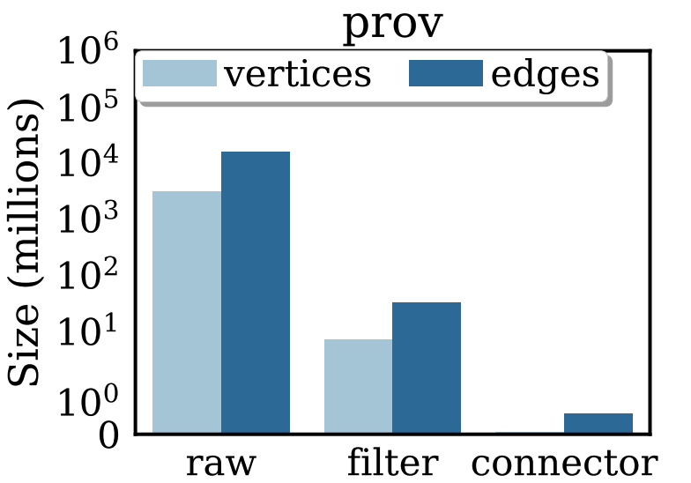
Example gains in size reduction
Original data lineage raw graph has billions of vertices and edges.
Notes:
As you saw earlier, depending on how much regularity as well as skew that you have in these input graphs, you can get orders of magnitude reduction when you compare the size of the final view vs the original raw data graph, going all the way from billions [NEXT SLIDE]

Slide 41
Example gains in size reduction
Graph view that filters out unnecessary vertex/edge types has millions of edges.
Notes:
to millions [NEXT SLIDE]

Slide 42
Example gains in size reduction
A 2-hop job-job connector graph view further reduces size.
Notes:
to hundreds of thousands of vertices and edges.

Slide 43
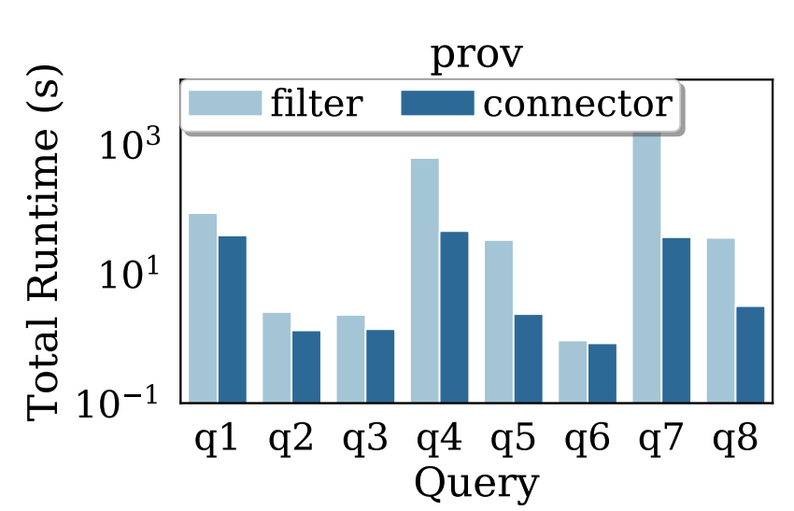
Example gains in query runtime
Runtime gains compound: orders of magnitude faster on smallest view.
Notes:
The query runtime gains compound accordingly, as we get orders of magnitude speedups as a side-effect of the graph size reduction. There are many other results in the thesis, including analysis of our cost model, as well as cases in which the graph view can actually be larger than the original graph, such as when there is little to no schema in the graph.

Slide 44
Kaskade: Key Technical Contributions
Graph view selection for query rewriting
Introduced class of graph views that are beneficial for different queries
Constraint-based view enumeration is guided by queries and structural properties of graph
Significant performance gains
Up to 50x faster response times, orders of magnitude reduction in size
Rewriting techniques are engine-agnostic: only rely on fundamental graph transformations
Notes:
To summarize, the system we designed and built performs automatic selection of sparser graph views, using a number of view templates. The view selection is guided by constraints that we can extract from the underlying graph and queries, and offers up to 50x of faster response times when compared with baselines without any graph view rewriting.
The primitives we use in this work are also graph engine-agnostic, in that they only rely on fundamental graph transformations, such as path contractions or edge and/or vertex removal operations.

Slide 45
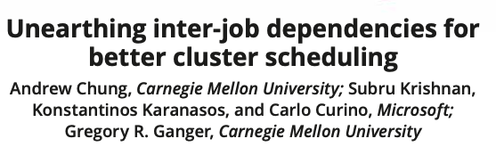
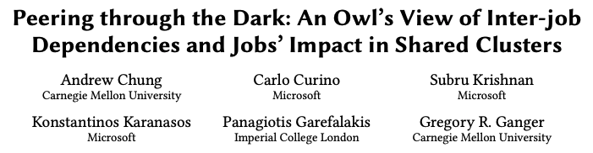
Kaskade: Misc. Contributions
Wrote graph views extraction pipeline, made available in prod
Pipeline served as basis for other papers from Microsoft folks, e.g.,
SIGMOD 2019
OSDI 2020
Notes:
Some secondary contributions of this Kaskade work is that I was fortunate enough in my collaboration with Microsoft folks (primarily Carlo and Kostas), in that I got access to lots of production logs, and put together this graph view extraction pipeline, making it available in prod. The other nice thing about that, is that some folks also used the data extracted by that pipeline, in particular the job-to-job dependency views in their work.
This is a good time to pause for questions, although I’d appreciate it if you can keep them for the end of the talk if possible. [ASK QUESTIONS]

Slide 46
Thesis Outline
Kaskade: Graph Views for Efficient Graph Analytics
J M F da Trindade, K Karanasos, C Curino, S Madden, J Shun
ICDE 2020
Kairos: Efficient Temporal Graph Analytics on a Single Machine
J M F da Trindade, J Shun, S Madden, N Tatbul
Under submission to VLDB 2024
Notes:
So now we can go to the second part of this talk, which is about a system and a couple of techniques I proposed for efficient temporal graph analytics.

Slide 47
Kairos: Key Technical Contributions
Efficient parallel implementation of algorithms over temporal graphs, e.g.
minimal paths (earliest arr., latest dep., fastest, shortest duration)
centrality (betweenness using fastest or shortest duration)
k-core, ranking, and connectivity
Efficient data layouts
T-CSR: compressed sparse row for temporal graphs
TGER: highly optimized parallel index for temporal edges
Selective Indexing
chooses best access method to retrieve vertex’s nbors at runtime
Notes:
As I mentioned in the beginning of this talk, the key contributions in Kairos are three-fold [READ FROM THE SLIDE]

Slide 48
What is a temporal graph?
G = (V, E, τ)
[0,3]
V = {1, 2, 3, 4}
[7,10]
[2,8]
E = {(1,2), (1,3), (2, 4), (3, 4)}
τ: E → ℕ x ℕ
[3,5]
AKA as “temporal network”: edges only valid during [start time, end time] interval
Notes:
So far we’ve sort of intuitively kept a notion of a temporal graph in our minds, but haven’t really defined concretely. The literature has several definitions that are related to graphs that capture relationships that evolve over time in some form or another.
In my work, when I say temporal graph, what I mean is that edges codify an interaction between two vertices with some noition of temporal validity, meaning that interaction had started at some discrete time t_x, or start time, and ended at some t_y or end time.
As such, in this data model, we map each edge to a tuple of two discrete time number, drawn from the set of natural numbers, and they are represented in that bracked notation you see there, with the first number being start time, and the second number being end time. [NEXT SLIDE -> JOKE ABOUT TEMPORAL GRAPHS]

Slide 49

But really, why temporal graphs?
Rick and Morty – A Rickle In Time (Season 2, Episode 1)
Notes:
But why, oh why, do I care so much about temporal graphs: and it really is not about just because I wanted to mess with time.

Slide 50
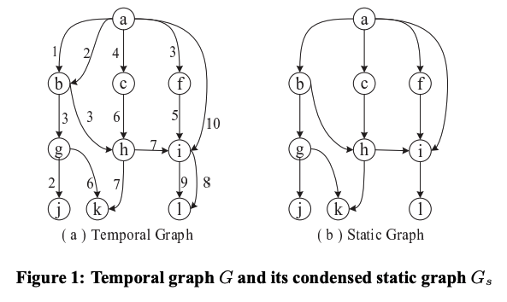
Why do we care about temporal graphs? Certain questions answered incorrectly without time info
Paths may be invalid or suboptimal when temporal info is ignored
- <a, b, g, j> is not valid
- <a, i, l> is not shortest
H. Wu et al, Path Problems in Temporal Graphs. VLDB 2014
Notes:
Furthermore, some graph queries and algorithms cannot be answered correctly without temporal information. For sake of simplicity, assume those temporal edges only start time. Then what happens if you drop, all of a sudden you can paths that are no longer valid or not shortest.

Slide 51
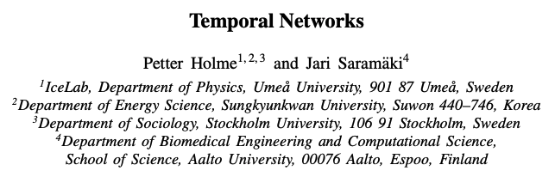

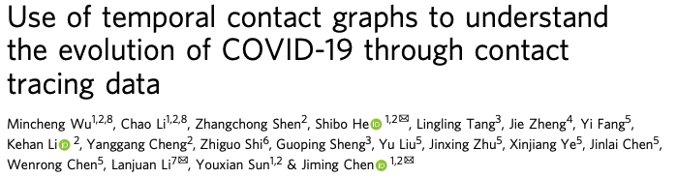
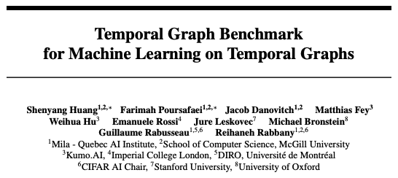
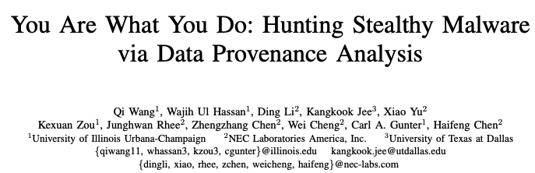
Why do we care about temporal graphs? Certain questions answered incorrectly without time info
Notes:
A number of folks in other fields care deeply abou temporal graphs as well, and here I’m showing a few examples. The top left paper, has over 3000 citations, and is one of the best references in the temporal graph literature. Temporal graphs also came into prominence during contact tracing efforts for COVID-19, and more recently a community with which I’ve gotten more involved released a benchmark for temporal graph learning tasks.

Slide 52
Kairos: Key Technical Contributions
Efficient parallel implementation of algorithms over temporal graphs, e.g.
minimal paths (earliest arr., latest dep., fastest, shortest duration)
centrality (betweenness using fastest or shortest duration)
k-core, ranking, and connectivity
Efficient data layouts
T-CSR: compressed sparse row for temporal graphs
TGER: highly optimized parallel index for temporal edges
Selective Indexing
chooses best access method to retrieve vertex’s nbors at runtime
Notes:
Now, for the rest of the talk I’ll try and briefly cover the major aspects of this work I did in Kairos to try and make a system that would efficiently answer a host of tasks that folks doing temporal graph analysis need.
I also want to take the time to remind folks that I DID NOT propose new temporal graph algorithms: rather, in my work I provide a system and techniques for efficient parallel implementations of these algorithms.

Slide 53
Categories of temporal graph analytics tasks
Temporal Minimal Paths
Provenance: tracking information flow in machine generated graphs
Indoor routing: temporal shortest paths for robot navigation
Epidemiology: identifying infection transmission paths for contact tracing
Temporal Connectivity
Social networks: analyzing community evolution
Temporal Centrality
Epidemiology: identifying critical nodes in the spread of infections
Time-constrained reachability
Social networks: analyzing influence propagation
Notes:
First, I categorize the different classes of temporal algorithms that folks use in the literature. Here I am showing a few examples of domains in which they are used. You can refer to thesis for more details.
In this talk I’ll only go over one example of minimal path (or in other words, a temporal variation of single source shortest path), as this is one of easiest ones to understand.

Slide 54
Example T. Minimal Path: Earliest Arrival
a
c
[1,2]
[3,6]
g
[7,14]
e
[11,12]
b
d
[5,8]
[9,10]
f
[2,4]
Input: graph G, source vertex u in V, time interval [t_{s}, t_{e}]
Output: earliest arrival from u to every vertex v in V within [t_{s}, t_{e}]
a b c d e f g
a b c d e f g
u = a
t_{s}
∞
∞
∞
∞
∞
∞
u = b
∞
t_{s}
∞
∞
∞
∞
∞
[t_{s}, t_{e}] = [1,15]
[t_{s}, t_{e}] = [2,11]
Notes:
So the example algorithm we’ll look into is what is referred to as “earliest arrival” shortest path. The input is a graph G. [NEXT]

Slide 55

Example T. Minimal Path: Earliest Arrival
a
c
[1,2]
[3,6]
g
[7,14]
e
[11,12]
b
d
[5,8]
[9,10]
f
[2,4]
Input: graph G, source vertex u in V, time interval [t_{s}, t_{e}]
Output: earliest arrival from u to every vertex v in V within [t_{s}, t_{e}]
a b c d e f g
a b c d e f g
u = a
t_{s}
∞
∞
∞
∞
∞
∞
u = b
∞
t_{s}
∞
∞
∞
∞
∞
[t_{s}, t_{e}] = [1,15]
[t_{s}, t_{e}] = [2,11]
Notes:
A source vertex u. In this case, we’re picking vertex a. [NEXT]

Slide 56
Example T. Minimal Path: Earliest Arrival
a
c
[1,2]
[3,6]
g
[7,14]
e
[11,12]
b
d
[5,8]
[9,10]
f
[2,4]
Input: graph G, source vertex u in V, time interval [t_{s}, t_{e}]
Output: earliest arrival from u to every vertex v in V within [t_{s}, t_{e}]
a b c d e f g
a b c d e f g
u = a
t_{s}
∞
∞
∞
∞
∞
∞
u = b
∞
t_{s}
∞
∞
∞
∞
∞
[t_{s}, t_{e}] = [1,15]
[t_{s}, t_{e}] = [2,11]
Notes:
And the third input a query time interval in the bracket notation of start time (or t_sub_s), comma end time (or t_sub_e). In this example, start time is set to 1, and and end time is set to 15. [NEXT]

Slide 57
Example T. Minimal Path: Earliest Arrival
a
c
[1,2]
[3,6]
g
[7,14]
e
[11,12]
b
d
[5,8]
[9,10]
f
[2,4]
Input: graph G, source vertex u in V, time interval [t_{s}, t_{e}]
Output: earliest arrival from u to every vertex v in V within [t_{s}, t_{e}]
a b c d e f g
a b c d e f g
u = a
u = b
∞
t_{s}
∞
∞
∞
∞
∞
[t_{s}, t_{e}] = [1,15]
[t_{s}, t_{e}] = [2,11]
Notes:
The output of this algorithm is the earliest arrival time from the input source vertex (in this case, a), to every other vertex in the graph, within the input temporal query interval of t_sub_s and t_sub_e. We’ll use this array here, with one position for each vertex to store the results as we go.

Slide 58
Example T. Minimal Path: Earliest Arrival
a
c
[1,2]
[3,6]
g
[7,14]
e
[11,12]
b
d
[5,8]
[9,10]
f
[2,4]
Input: graph G, source vertex u in V, time interval [t_{s}, t_{e}]
Output: earliest arrival from u to every vertex v in V within [t_{s}, t_{e}]
a b c d e f g
a b c d e f g
u = a
t_{s}
u = b
∞
t_{s}
∞
∞
∞
∞
∞
[t_{s}, t_{e}] = [1,15]
[t_{s}, t_{e}] = [2,11]
Notes:
First, we initialize the array using a convention dictated by the algorithm definition, which is to set the distance from the source vertex to itself as the start time of the input query interval.

Slide 59
Example T. Minimal Path: Earliest Arrival
a
c
[1,2]
[3,6]
g
[7,14]
e
[11,12]
b
d
[5,8]
[9,10]
f
[2,4]
Input: graph G, source vertex u in V, time interval [t_{s}, t_{e}]
Output: earliest arrival from u to every vertex v in V within [t_{s}, t_{e}]
a b c d e f g
a b c d e f g
u = a
1
u = b
∞
t_{s}
∞
∞
∞
∞
∞
[t_{s}, t_{e}] = [1,15]
[t_{s}, t_{e}] = [2,11]

Slide 60
Example T. Minimal Path: Earliest Arrival
a
c
[1,2]
[3,6]
g
[7,14]
e
[11,12]
b
d
[5,8]
[9,10]
f
[2,4]
Input: graph G, source vertex u in V, time interval [t_{s}, t_{e}]
Output: earliest arrival from u to every vertex v in V within [t_{s}, t_{e}]
a b c d e f g
a b c d e f g
u = a
1
∞
∞
∞
∞
∞
∞
u = b
∞
t_{s}
∞
∞
∞
∞
∞
[t_{s}, t_{e}] = [1,15]
[t_{s}, t_{e}] = [2,11]
Notes:
And set the earliest arrival time for every other vertex to plus infinity.

Slide 61
Example T. Minimal Path: Earliest Arrival
a
c
[1,2]
[3,6]
g
[7,14]
e
[11,12]
b
d
[5,8]
[9,10]
f
[2,4]
a b c d e f g
a b c d e f g
u = a
1
∞
2
u = b
∞
t_{s}
∞
∞
∞
∞
∞
[t_{s}, t_{e}] = [1,15]
[t_{s}, t_{e}] = [2,11]
Notes:
Now we hop on our Green Line Extension Boston T train and traverse our temporal graph. The earliest we can get to vertex c, in this case, is t=2, which is the end time of the last edge connecting us to vertex c.

Slide 62
Example T. Minimal Path: Earliest Arrival
a
c
[1,2]
[3,6]
g
[7,14]
e
[11,12]
b
d
[5,8]
[9,10]
f
[2,4]
a b c d e f g
a b c d e f g
u = a
1
∞
2
∞
6
u = b
∞
t_{s}
∞
∞
∞
∞
∞
[t_{s}, t_{e}] = [1,15]
[t_{s}, t_{e}] = [2,11]
Notes:
Similarly, the earliest we can to vertex e is t=6.

Slide 63
Example T. Minimal Path: Earliest Arrival
a
c
[1,2]
[3,6]
g
[7,14]
e
[11,12]
b
d
[5,8]
[9,10]
f
[2,4]
a b c d e f g
a b c d e f g
u = a
1
∞
2
∞
6
∞
14
u = b
∞
t_{s}
∞
∞
∞
∞
∞
[t_{s}, t_{e}] = [1,15]
[t_{s}, t_{e}] = [2,11]
Notes:
Now, unfortunately, the direct edge to vertex g is known to be a slow zone, so we can only get there at t=14 if we use this edge.

Slide 64
Example T. Minimal Path: Earliest Arrival
a
c
[1,2]
[3,6]
g
[7,14]
e
[11,12]
b
d
[5,8]
[9,10]
f
[2,4]
a b c d e f g
a b c d e f g
u = a
1
∞
2
∞
6
10
14
u = b
∞
t_{s}
∞
∞
∞
∞
∞
[t_{s}, t_{e}] = [1,15]
[t_{s}, t_{e}] = [2,11]
Notes:
Fortunately, we have another option which will get us there sooner: we can first take the edge to vertex f.

Slide 65
Example T. Minimal Path: Earliest Arrival
a
c
[1,2]
[3,6]
g
[7,14]
e
[11,12]
b
d
[5,8]
[9,10]
f
[2,4]
a b c d e f g
a b c d e f g
u = a
1
∞
2
∞
6
10
12
u = b
∞
t_{s}
∞
∞
∞
∞
∞
[t_{s}, t_{e}] = [1,15]
[t_{s}, t_{e}] = [2,11]
Notes:
And then we can get to g by t=12, which is earlier, so we can update the earliest arrival time to g accordingly.

Slide 66
Example T. Minimal Path: Earliest Arrival
a
c
[1,2]
[3,6]
g
[7,14]
e
[11,12]
b
d
[5,8]
[9,10]
f
[2,4]
a b c d e f g
a b c d e f g
u = a
1
∞
2
∞
6
10
12
u = b
∞
2
∞
∞
∞
∞
∞
[t_{s}, t_{e}] = [1,15]
[t_{s}, t_{e}] = [2,11]
Notes:
Now for another example, say instead our source vertex is b, and that our input query interval now starts at 2, and ends at 11.
We initialize our output array as before, with the start time as the convention for earliest arrival to the source vertex, as well as plus infinity for all other vertices.
[JOKE] Now, we’ll use a little bit of time travel…

Slide 67
Example T. Minimal Path: Earliest Arrival
a
c
[1,2]
[3,6]
g
[7,14]
e
[11,12]
b
d
[5,8]
[9,10]
f
[2,4]
a b c d e f g
a b c d e f g
u = a
1
∞
2
∞
6
10
12
u = b
∞
2
∞
4
8
10
∞
[t_{s}, t_{e}] = [1,15]
[t_{s}, t_{e}] = [2,11]
Notes:
And get to the last hops in our little Green Line Extension Boston T train. We can arrive to vertex f by time t=10, which is still under the end time of 11 from our input query interval.

Slide 68

Example T. Minimal Path: Earliest Arrival
a
c
[1,2]
[3,6]
g
[7,14]
e
[11,12]
b
d
[5,8]
[9,10]
f
[2,4]
a b c d e f g
a b c d e f g
u = a
1
∞
2
∞
6
10
12
u = b
∞
2
∞
4
8
10
∞
[t_{s}, t_{e}] = [1,15]
[t_{s}, t_{e}] = [2,11]
Notes:
Notice that in this case, however, we cannot reach vertex g from b in time.
This because the time of all edges that connect us to g is larger than the end time of the input query interval. There is no other route left, so we cannot reach vertex g from b within the input query interval starting at t=2 and ending at t=11.

Slide 69
Efficient parallel implementations
b
f
…
Extends Ligra to temporal setting:
- can process each frontier in parallel
temporalEdgeMap(vertexSet, …):
- applies fn to all vertices in each parallel frontier
update(temporalEdge):
- applies fn to all nbors in each parallel frontier
see thesis for details
c
g
…
a
d
h
…
e
i
…
Notes:
So now that we looked at this serial implementation of a temporal single source shortest path, what do we need to make it parallel.
The thesis has a lot more details on this, but the key intuition is that we can process each frontier in a graph parallel. That same output array we saw in the previous slide can be populated in parallel as we traverse the graph in this manner. [ARROW]

Slide 70
Efficient parallel implementations
b
f
…
Extends Ligra to temporal setting:
- can process each frontier in parallel
temporalEdgeMap(vertexSet, …):
- applies fn to all vertices in each parallel frontier
update(temporalEdge):
- applies fn to all nbors in each parallel frontier
see thesis for details
c
g
…
a
d
h
…
e
i
…

Slide 71
Efficient parallel implementations
b
f
…
Extends Ligra to temporal setting:
- can process each frontier in parallel
temporalEdgeMap(vertexSet, …):
- applies fn to all vertices in each parallel frontier
update(temporalEdge):
- applies fn to all nbors in each parallel frontier
see thesis for details
c
g
…
a
d
h
…
e
i
…
Notes:
Then making efficient temporal graph algorithms becomes a case of defining the right programming primitives and extensions so that can both efficiently capture, as well as surface temporal edge information to a state-of-the-art parallel graph processing system.

Slide 72
Efficient parallel implementations
b
f
…
Extends Ligra to temporal setting:
- can process each frontier in parallel
temporalEdgeMap(vertexSet, …):
- applies fn to all vertices in each parallel frontier
update(temporalEdge):
- applies fn to all nbors in each parallel frontier
see thesis for details
c
g
…
a
d
h
…
e
i
…
Julian Shun et al, “Ligra: A Lightweight Graph Processing for Shared Memory.”
Julian Shun et al, “Smaller and Faster: Parallel Processing of Compressed Graphs with Ligra+”
Notes:
My all-time favorite system for this is Ligra, which just so happens to have been the PhD thesis of one of my committee members present in the audience.

Slide 73
Kairos API extends Ligra to temporal setting
Interface | Description
VertexSet | Represents a subset of vertices 𝑉′ ⊆ 𝑉
TemporalEdgeSet | Represents a subset of temporaledges 𝐸′ ⊆ 𝐸.
OrderingPredicate(𝐴: temporaledge, 𝐵: temporaledge, 𝑇 : OrderingPredicate-Type): bool | Evaluates the order between two temporal edges based on one of the three ordering predicate types: Succeeds, StrictlySucceeds, or Overlaps
TemporalGraph(𝑉: VertexSet, 𝐸: TemporalEdgeSet, 𝑃: OrderingPredicate) | Constructs a temporal graph using given input vertices, temporaledges, and ordering predicate.
VertexMap(𝑈 : VertexSet, 𝐺 : TemporalGraph, 𝐹 : vertex → bool): VertexSet | Applies 𝐹(𝑢) for each 𝑢 ∈ 𝑈; returns a VertexSet{𝑢 ∈ 𝑈 | 𝐹(𝑢)=true}.
TemporalEdgeMap(𝑈:TemporalEdgeSet, 𝐺:TemporalGraph, 𝐹:temporaledge → bool): TemporalEdgeSet | Applies 𝐹(𝑢) for each 𝑢 ∈ 𝑈; returns a TemporalEdgeSet{𝑢 ∈ 𝑈 |𝐹(𝑢)=true}.
Notes:
Here’s a table of some of the programming primitives and extension we made to Ligra so we that we could use its parallel graph processing capabilities to write really efficient graph algorithms (both temporal and non-temporal) over temporal graphs. You again check out the thesis for more details.

Slide 74
Kairos: Key Technical Contributions
Efficient parallel implementation of algorithms over temporal graphs, e.g.
minimal paths (earliest arr., latest dep., fastest, shortest duration)
centrality (betweenness using fastest or shortest duration)
k-core, ranking, and connectivity
Efficient data layouts
T-CSR: compressed sparse row for temporal graphs
TGER: highly optimized parallel index for temporal edges
Selective Indexing
chooses best access method to retrieve vertex’s nbors at runtime
Notes:
Now for those programming primitives to be efficient, we also need an efficient data representation for these temporal graphs. In Kairos, we introduce two such representations.

Slide 75
Problem: efficient graph data layout
a b c d e f g h i
a
0 | 1 | 1 | 1 | 1 | 0 | 0 | 0 | 0
0 | 0 | 0 | 0 | 0 | 1 | 0 | 0 | 0
0 | 0 | 0 | 0 | 0 | 1 | 1 | 1 | 1
0 | 0 | 0 | 0 | 0 | 0 | 0 | 1 | 1
0 | 0 | 0 | 0 | 0 | 0 | 0 | 0 | 1
0 | 0 | 0 | 0 | 0 | 0 | 0 | 0 | 0
0 | 0 | 0 | 0 | 0 | 0 | 0 | 0 | 0
0 | 0 | 0 | 0 | 0 | 0 | 0 | 0 | 0
0 | 0 | 0 | 0 | 0 | 0 | 0 | 0 | 0
b
f
b
c
c
g
d
>85% zeros
a
e
d
h
f
g
e
i
h
i
Adjacency matrix is not space efficient for sparse graphs
Notes:
Now, if you recall from graph theory, there are number of trade-offs in different graph data representations, or data layouts. You can try and store your graph as an adjacency matrix, in which each position indicates the existence of an edge.
This is highly parallelizable, and in fact it’s one of the representations used in Graph Neural Networks. However, it has this terrible disadvantage for sparse graphs: it wastes a lot of space, since most of your data will be zeros.

Slide 76
Problem: efficient graph data layout
adjacency list:
edge list:
a
b
c
d
e
f
g
h
i
b
f
f
h
i
c
g
d
h
e
i
(a,b)
(a,c)
(a,d)
(a,e)
(b,f)
(c,f)
(c,g)
(c,h)
(c,i)
(d,h)
(e,i)
b
f
c
g
a
pointer chasing
d
h
e
need scan to find
src vertex offset
i
Adjacency list and edge list use less space, but are not cache efficient
Notes:
We can try and make this a little better by using either a adjacencly list, or an edge list. Which leads us to yet another problem: both of these are cache inefficient. You’ll do a lot of pointer chasing with the adjacency list, and you don’t know where the neighbors of a given source vertex start if you don’t do a scan first.

Slide 77
Solution: T. Compressed Sparse Row (T-CSR)
[1,2]
a
c
[3,6]
[7,14]
g
e
b
d
[9,10]
f
[11,12]
[2,4]
[5,8]
position where
nbors start in the other arrays
a b c d e f g
offsets:
0 | 1 | 2 | 3 | 4 | 6 | 6
s. time:
dest. id:
e. time:
Notes:
Instead, what we can use is something called Compressed Sparse Row, which is this format originally targeted at sparse matrix computations, and used in a number of parallel graph processing engines, including Ligra.
You can think of it as a version of edge list which is all edges are sorted by source vertex id, and we can then use a prefix sum to precalculate offsets into the edge array.

Slide 78
Solution: T. Compressed Sparse Row (T-CSR)
[1,2]
a
c
[3,6]
[7,14]
g
e
b
d
[9,10]
f
[11,12]
[2,4]
[5,8]
a b c d e f g
offsets:
0 | 1 | 2 | 3 | 4 | 6 | 6
s. time:
1
dest. id:
c
e. time:
2
Notes:
Think of it as a version of edge list which is sorted by source vertex, and uses prefix sum to precalculate offsets into the edge array.

Slide 79
Solution: T. Compressed Sparse Row (T-CSR)
[1,2]
a
c
[3,6]
[7,14]
g
e
b
d
[9,10]
f
[11,12]
[2,4]
[5,8]
a b c d e f g
offsets:
0 | 1 | 2 | 3 | 4 | 6 | 6
s. time:
1 | 2
dest. id:
c | d
e. time:
2 | 4
Notes:
Animate the architecture to go over the three main parts of the contribution
T-csr representation
Selective Indexing at a high level: the large vertices
Hint at class trade-off in DBs (scan vs indexing)

Slide 80
Solution: T. Compressed Sparse Row (T-CSR)
[1,2]
a
c
[3,6]
[7,14]
g
e
b
d
[9,10]
f
[11,12]
[2,4]
[5,8]
a b c d e f g
offsets:
0 | 1 | 2 | 3 | 4 | 6 | 6
s. time:
1 | 2 | 3 | 5 | 9
dest. id:
c | d | e | e | f
e. time:
2 | 4 | 6 | 8 | 10

Slide 81
Solution: T. Compressed Sparse Row (T-CSR)
[1,2]
a
c
[3,6]
[7,14]
g
e
b
d
[9,10]
f
[11,12]
[2,4]
[5,8]
a b c d e f g
offsets:
0 | 1 | 2 | 3 | 4 | 6 | 6
s. time:
1 | 2 | 3 | 5 | 9 | 7
dest. id:
c | d | e | e | f | g
e. time:
2 | 4 | 6 | 8 | 10 | 14

Slide 82
Solution: T. Compressed Sparse Row (T-CSR)
[1,2]
a
c
[3,6]
[7,14]
g
e
b
d
[9,10]
f
[11,12]
[2,4]
[5,8]
a b c d e f g
offsets:
0 | 1 | 2 | 3 | 4 | 6 | 6
s. time:
1 | 2 | 3 | 5 | 9 | 7 | 11
dest. id:
c | d | e | e | f | g | g
e. time:
2 | 4 | 6 | 8 | 10 | 14 | 12

Slide 83
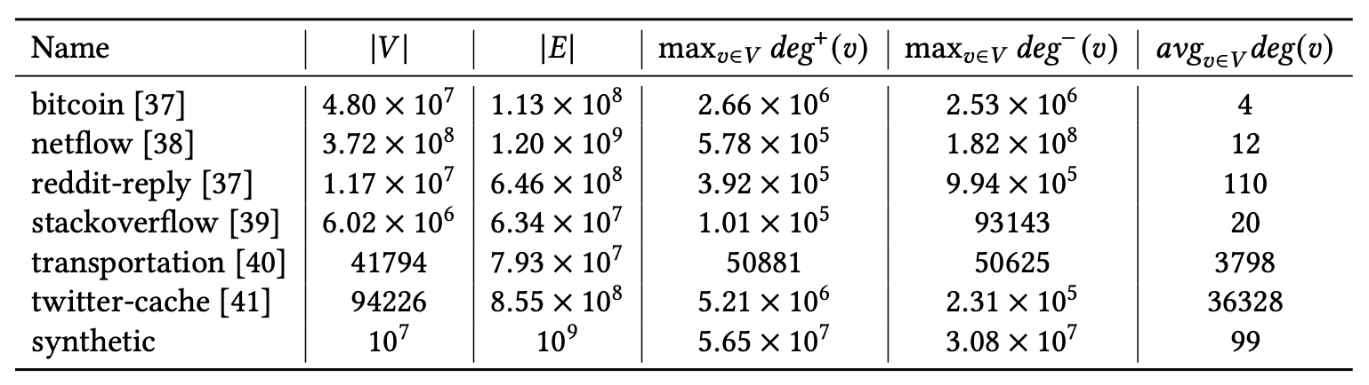
Problem: T-CSR still requires linear scan
Parallel scan starting at vertex offset is cache efficient, but still O(degree)
In real-world graphs, single vertex degree can be O(Millions)
Notes:
But a problem still remains: vertex neighborhoods can be really large in real-world graphs. So even an efficient representation like CSR can still be expensive and not always a good option.
For example, if your input query interval is highly selective (meaning: only a small fraction of your outgoing edges match the input temporal predicate filter), then you’ll still have to scan the entire neighborhood, which is wasteful.

Slide 84
Solution: T. Graph Edge Registry (TGER)
Corresponding TGER:
input vertex out-neighbors:
[4,5]
[9,13]
[2,4]: f
mid: 6
a
g
[3,6]
[2,4]
[3,6]: b
mid: 5
[6,9]: d
mid: 9
b
[5,7]
[8,10]
f
[6,9]
c
e
d
[4,5]: a
mid: 5
[5,7]: c
mid: 7
[8,10]: e
mid: 10
[9,13]: g
mid: 13
Notes:
So in this case, we have another data representation, one in which we index temporal edges by their start and end times. We call this TGER (Temporal Graph Edge Registry).

Slide 85
Solution: T. Graph Edge Registry (TGER)
Corresponding TGER:
input vertex out-neighbors:
[4,5]
[9,13]
[2,4]: f
mid: 6
a
g
[3,6]
[2,4]
[3,6]: b
mid: 5
[6,9]: d
mid: 9
b
[5,7]
[8,10]
f
[6,9]
c
e
d
[4,5]: a
mid: 5
[5,7]: c
mid: 7
[8,10]: e
mid: 10
[9,13]: g
mid: 13
acts as heap on start times
Notes:
The nice thing about TGER is that it a reconfigurable data structure inspired by Priority Search Trees, in which you can sort points (in our case, edges) by two dimensions at the same time. In this example, we are sorting all edges by their start time as a min-heap (or min-priority queue).

Slide 86
Solution: T. Graph Edge Registry (TGER)
Corresponding TGER:
input vertex out-neighbors:
[4,5]
[9,13]
[2,4]: f
mid: 6
a
g
[3,6]
[2,4]
[3,6]: b
mid: 5
[6,9]: d
mid: 9
b
[5,7]
[8,10]
f
[6,9]
c
e
d
[4,5]: a
mid: 5
[5,7]: c
mid: 7
[8,10]: e
mid: 10
[9,13]: g
mid: 13
acts as heap on start times
acts as BST on end times
Notes:
And at the same time, we are also sorting edges by their end time as a binary search tree.

Slide 87
Solution: T. Graph Edge Registry (TGER)
Corresponding TGER:
input vertex out-neighbors:
[4,5]
[9,13]
[2,4]: f
mid: 6
a
g
[3,6]
[2,4]
[3,6]: b
mid: 5
[6,9]: d
mid: 9
b
[5,7]
[8,10]
f
[6,9]
c
e
d
[4,5]: a
mid: 5
[5,7]: c
mid: 7
[8,10]: e
mid: 10
[9,13]: g
mid: 13
acts as heap on start times
parallel construction (see thesis for details):
- parallel sort edges by start time, root is first element
- recurse: split subtrees by left and right of median end time
acts as BST on end times
Notes:
Again, you can check out the thesis for more details on the parallel algorithms I introduce for both building and querying this tree-like index. You can also see a discussion comparing it to alternative range query indexes traditionally used both in relational query processing settings, as well as used for storing interval data. Another aspect I don’t have time to cover is how this index is reconfigurable at runtime, and the temporalEdgeMap primitive I mentioned before can assign different ends of the interval, as well as change from min to max heap as needed by some variations of temporal walks.

Slide 88
TGER supports 3-sided queries in log(n) + k
[2,4]: f
mid: 6
[3,6]: b
mid: 5
[6,9]: d
mid: 9
[4,5]: a
mid: 5
[5,7]: c
mid: 7
[8,10]: e
mid: 10
[9,13]: g
mid: 13
3-sided:
- 1-side (upper range) for heap dimension
- 2-sides (lower + upper range) for BST dimension
Notes:
Just one quick set of final examples here, in the thesis I introduce parallel algorithm for efficiently answering these queries, which I won’t cover here. For now, we can look at what the query API for this guy, as it’s a little different (it uses what is referred to as 3-sided queries).

Slide 89
TGER supports 3-sided queries in log(n) + k
Q1: start time: (-∞, 6], end time: [6, 9]
[2,4]: f
mid: 6
[3,6]: b
mid: 5
[6,9]: d
mid: 9
k = 2 results
[4,5]: a
mid: 5
[5,7]: c
mid: 7
[8,10]: e
mid: 10
[9,13]: g
mid: 13
3-sided:
- 1-side (upper range) for heap dimension
- 2-sides (lower + upper range) for BST dimension
Notes:
And what do we mean by 3-sided? You can specify 2-sides (or a lower and an upper range) for one of the dimensions, which in this case the end time of the intervals. And then 3rd side is, in this case, an upper range for the other dimension of the interval (which here is start time).
This is what looks like for a query asking for all intervals in which start time ends at 6, and end time is between 6 and 9.

Slide 90
TGER supports 3-sided queries in log(n) + k
[2,4]: f
mid: 6
[3,6]: b
mid: 5
[6,9]: d
mid: 9
k = 3 results
[4,5]: a
mid: 5
[5,7]: c
mid: 7
[8,10]: e
mid: 10
[9,13]: g
mid: 13
Q2: start time: (-∞, 5], end time: [5, 8]
3-sided:
- 1-side (upper range) for heap dimension
- 2-sides (lower + upper range) for BST dimension
Notes:
And similarly, a query in which start times end at 5, and end times are between 5 and 8.

Slide 91
TGER supports 3-sided queries in log(n) + k
[2,4]: f
mid: 6
[3,6]: b
mid: 5
[6,9]: d
mid: 9
k = 3 results
[4,5]: a
mid: 5
[5,7]: c
mid: 7
[8,10]: e
mid: 10
[9,13]: g
mid: 13
Q2: start time: (-∞, 5], end time: [5, 8]
3-sided:
- 1-side (upper range) for heap dimension
- 2-sides (lower + upper range) for BST dimension
parallel query processing (see thesis for details):
- per worker: local array stores results
- final merge: prefix sum
Notes:
More detail on the thesis on how these queries can be made parallel. I’ve rewritten my implementation so many times, and the fastest version was this one in which workers store their results in local arrays, and then results are merged with a prefix sum.

Slide 92
Problem: scan vs index trade-off
T-CSR
Good parallelism: scan over arrays
O(n) query complexity: not great when n is large
TGER
O(log n + k) query complexity: beats T-CSR when k <<< n
Tree-like data structure: parallelism is not as efficient
Notes:
Then we arrive at this other problem, which is: now we have two alternative representations. What are they good for, right? And when should I use one vs the other? Can I use both?

Slide 93
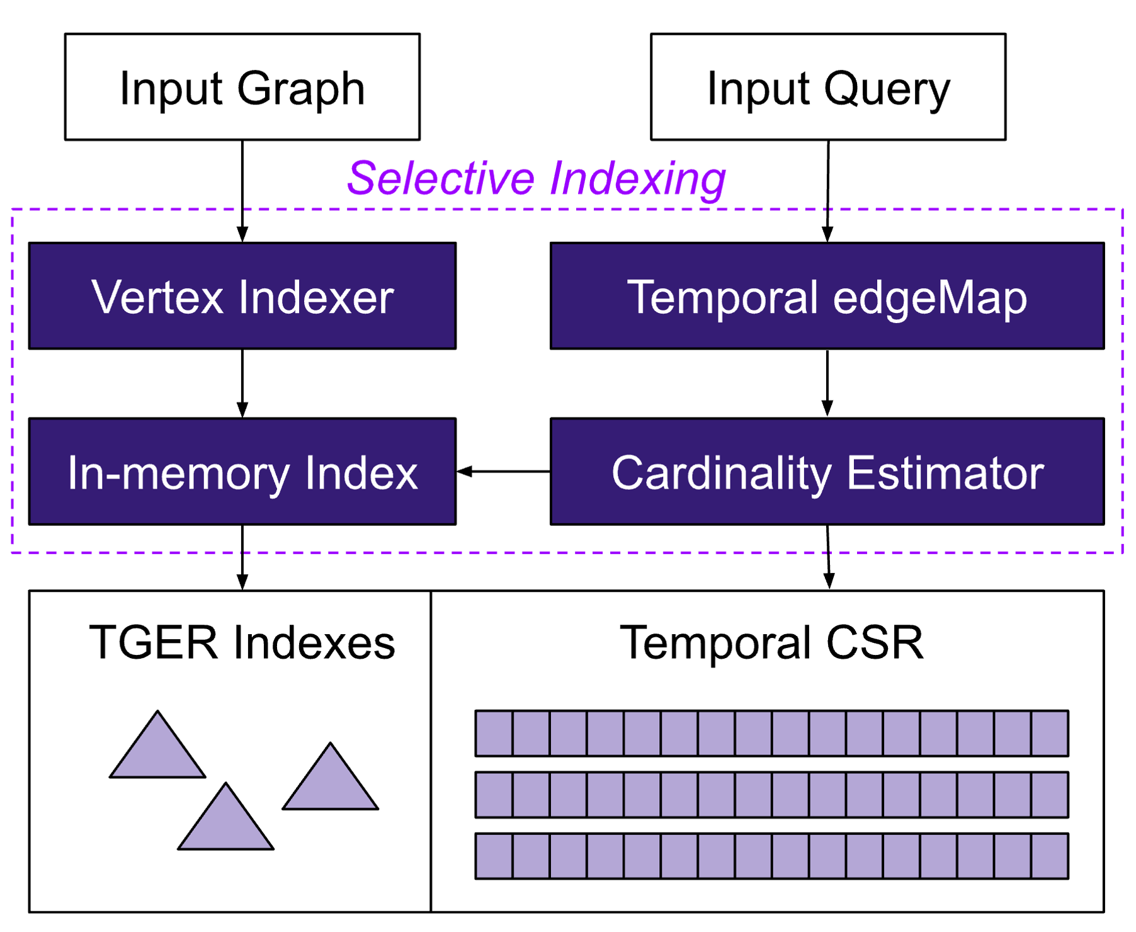
Solution: Selective Indexing
Two data representations for
in-memory temporal edges
Notes:
The solution we came up with as to introduce this notion of selective indexing. If you recall from the beginning of the talk, I mentioned how some vertices are way more special than others: and now we can actually extract that information, and then use it to decide which of these representations is more beneificial, and when.

Slide 94
Solution: Selective Indexing
Offline: build index
for large vertices
Notes:
So only the largest vertices get a TGER index for them, and all vertices get a slot on the T-CSR (and we’ll briefly discuss why).

Slide 95
Solution: Selective Indexing
At runtime, cost model
guides access method
decision (index vs scan)
Notes:
Then at runtime, we have a cost model that decides which of these two access methods to use. [NEXT IS THE COST MODEL]

Slide 96
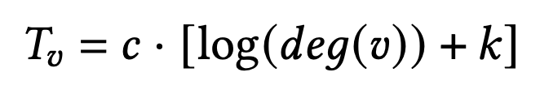
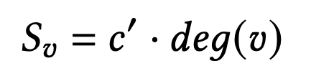
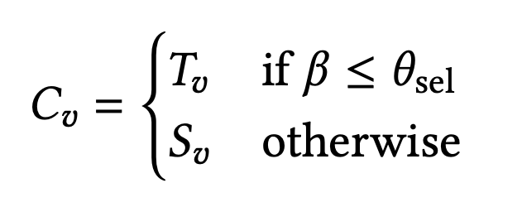
Selective Indexing: Cost Model
Impacting factors
Vertex degree distribution
Temporal edges distribution
Query workload (e.g., selectivity)
cost of accessing nbors using TGER
cost of accessing nbors using T-CSR
Notes:
We use a cardinality estimator that takes into account information about temporal correlations in the data to estimate query selectivity of input query interval filter predicates.
Then the cost model uses the estimated query selectivity as well other data properties to decide which access method to choose.
Alright, so next we’ll take a look at some of the result we get with this sort of hybrid approach.

Slide 97
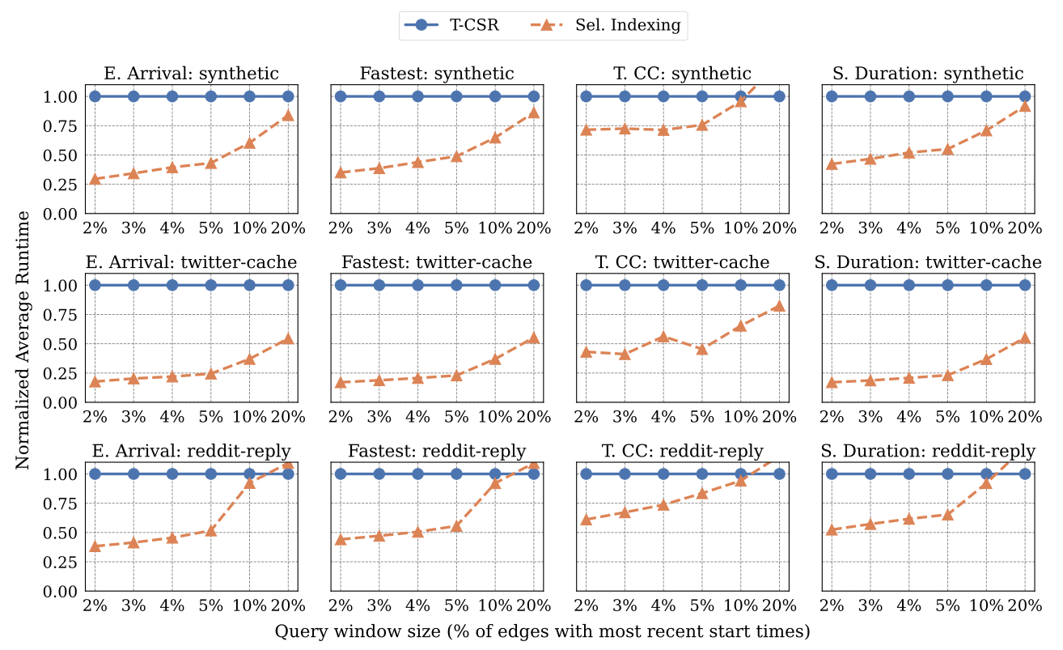
Experimental Results (see thesis for more)
Notes:
This is a subset of the evaluation, here I’ll just focus on this baseline I wrote, which uses T-CSR for all vertices, versus the selective indexing approach.

Slide 98
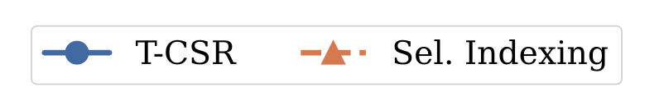
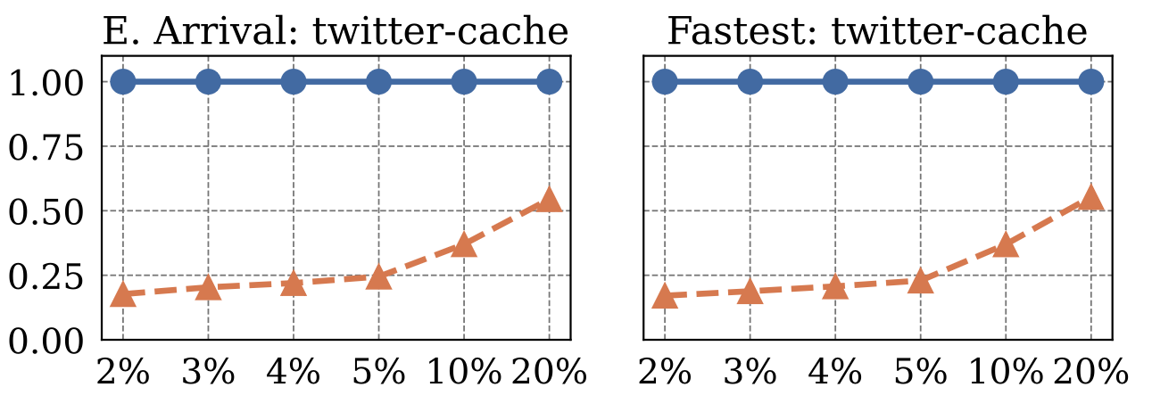
Experimental Results (see thesis for more)
Notes:
So as you can see, on the X axis we’re varying the selectivity of that input temporal query interval, or filter predicate. We size it so that it matches against exact fractions of the most recent edges.
And then we can see that the hybrid approach beats the baseline for the most selective queries [NEXT]

Slide 99
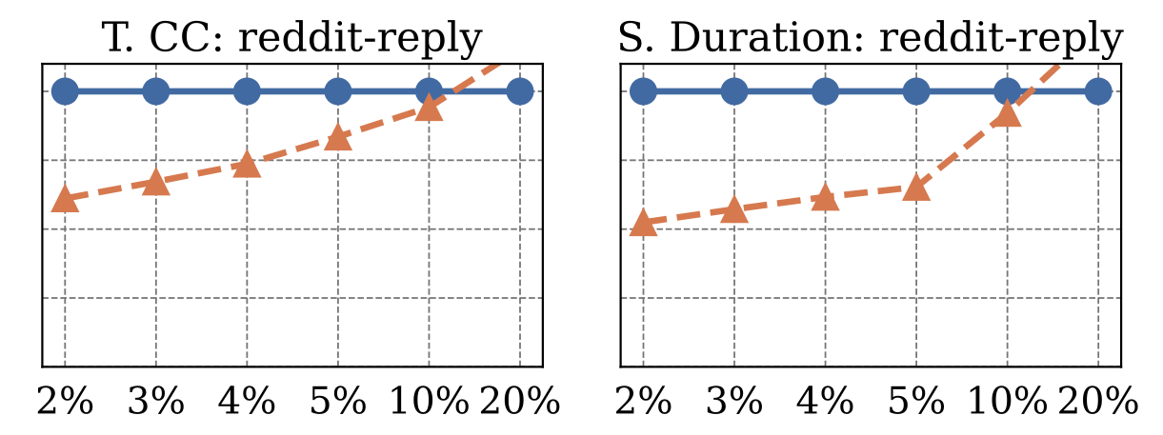
Experimental Results (see thesis for more)
Notes:
And then for smaller datasets, the selective indexing approach actually starts underperforming the T-CSR approach.
There are a few reasons for this, but the most likely culprit here is that in smaller graphs, the cardinality estimates end up less accurate. The cardinality estimator builts a 2D-histogram per vertex, so we have less samples here, and in this particular case, may have end up underestimating the selectivity.

Slide 100
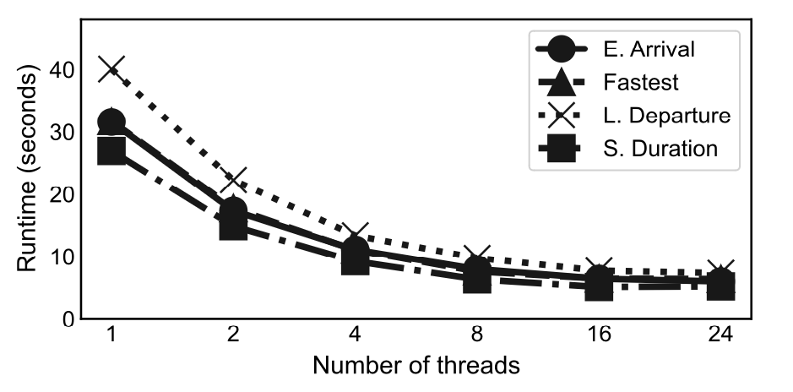
Experimental Results (see thesis for more)
O(secs): orders of magnitude
faster than distributed engines
500M edges synthetic data set (aggressively skewed)
Notes:
And just so you get a sense of total runtimes, here’s a plot showing the speedups we get as we increase the number of cores. This is an average of 10 runs, in which each run goes runs single source shortest paths using the top 100 largest vertices in the graph.
You can see that even with a single core, we already get really good runtimes (about 40 seconds in the worst case) for a synthetic dataset with 500M edges, in which skews are aggressive in both degres as well as inter-arrival times for the temporal edges. And this

Slide 101
Kairos Contributions
Selective Indexing chooses best access method to retrieve vertex’s nbors
TGER: highly optimized parallel index for temporal edges
Efficient parallel implementation of algorithms over temporal graphs
Good performance gains
Orders of magnitude vs distributed alternatives for graphs that fit within a single server
T-CSR baseline already good, but TGER is better for highly selective queries
Other contributions
Work w/ Intel collaborators: Optane NVRAM for storing TGER indexes
Open-sourced T-CSR baseline last year; open source remaining after paper acceptance
Notes:
In summary,

Slide 102
Future Work
Kaskade
Expand view types
Incremental view maintenance + automated view management
Kairos
TGER and T-CSR dynamism: support edge removal / insertion
Data compression + adaptive indexing instead of binary decision
Distributed processing: requires skew-aware partitioning
Integrate both systems
Temporal views: time-respecting path contractions can lead to view explosion
Selective indexing naturally extends to non-temporal settings
Notes:
[Mention ordering predicates on “temporal views”]

Slide 103


Acknowledgements (Sam and Julian)

Slide 104
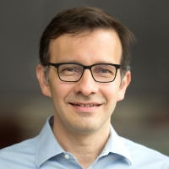
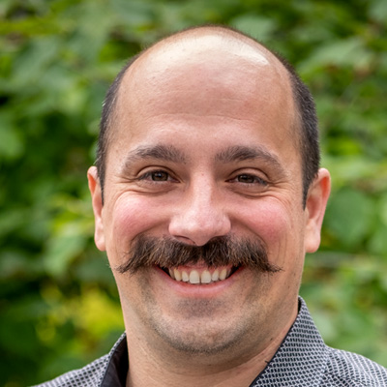

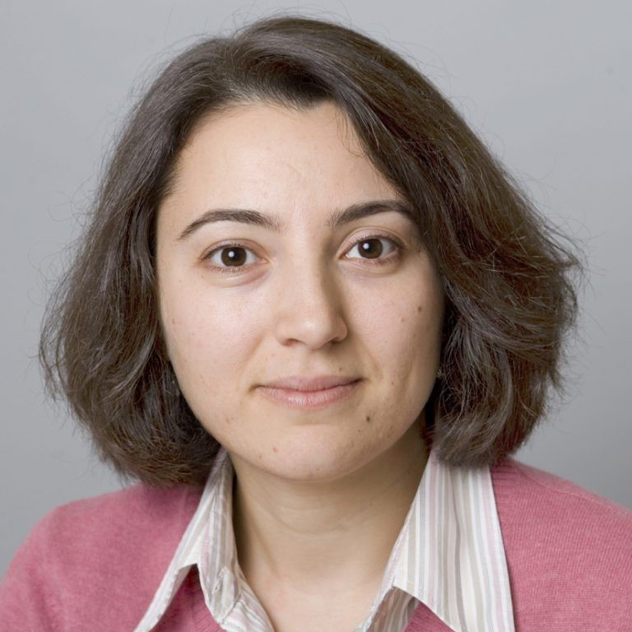
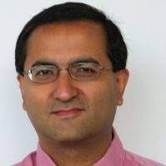

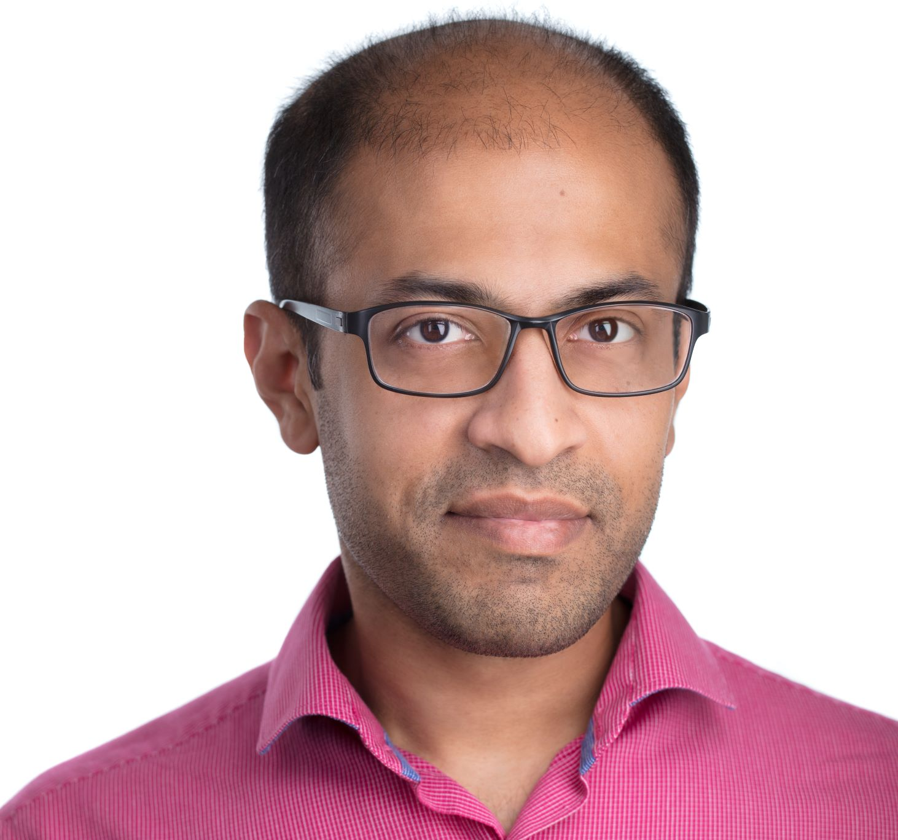
Acknowledgements (Committee + Collabs)

Slide 105

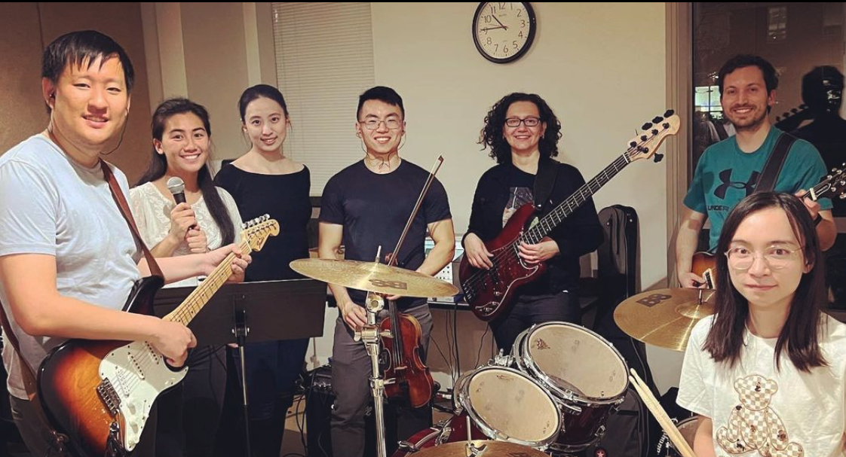

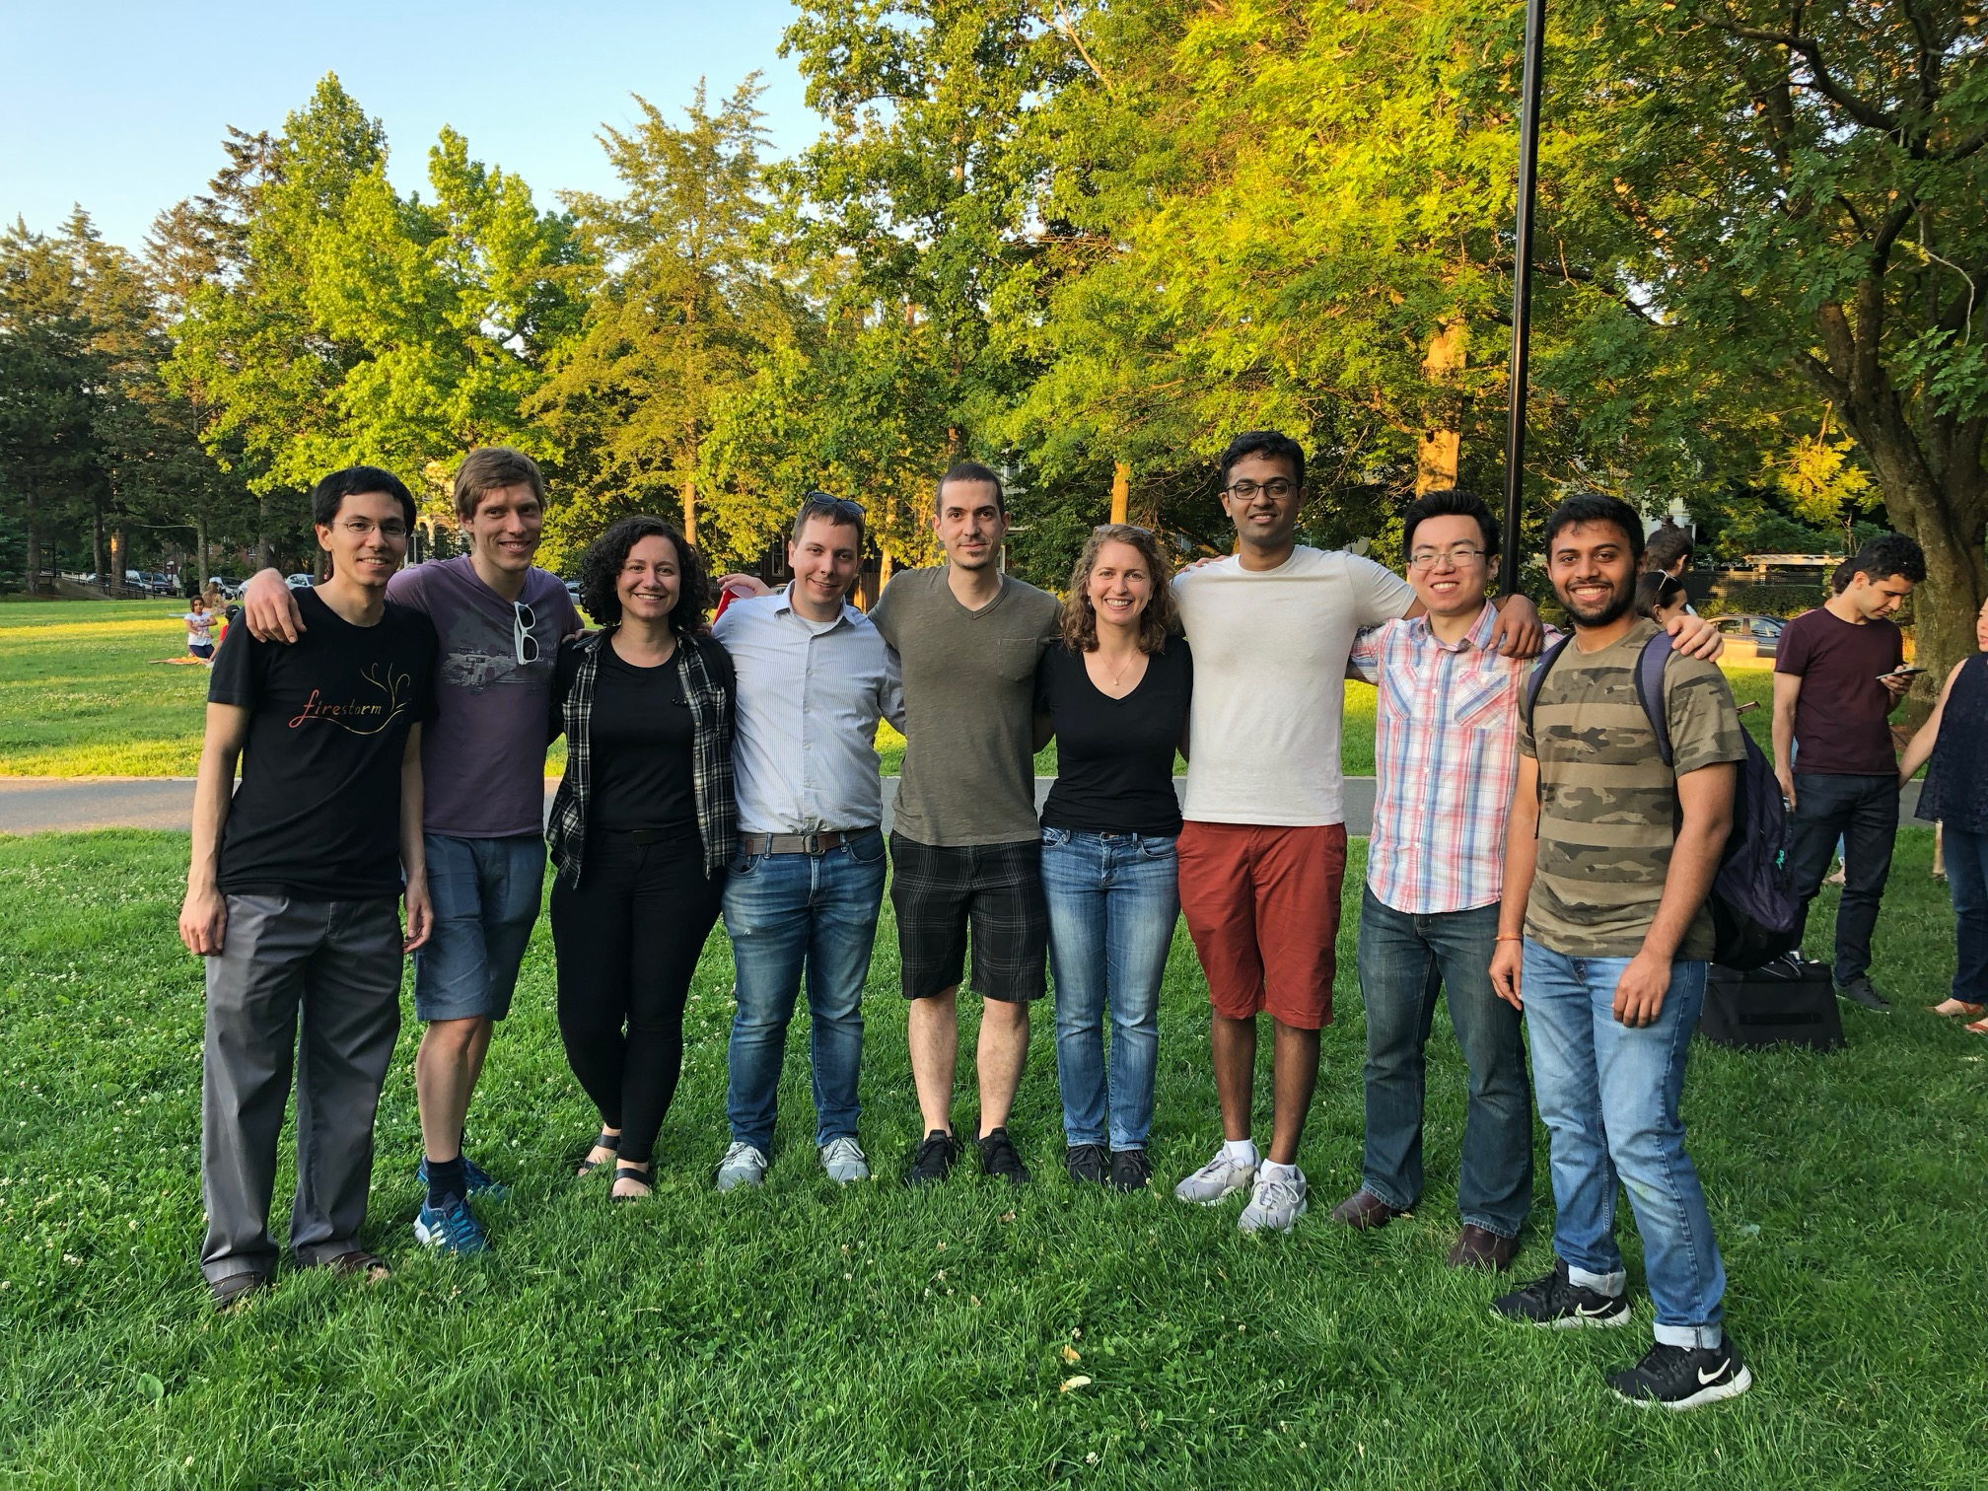
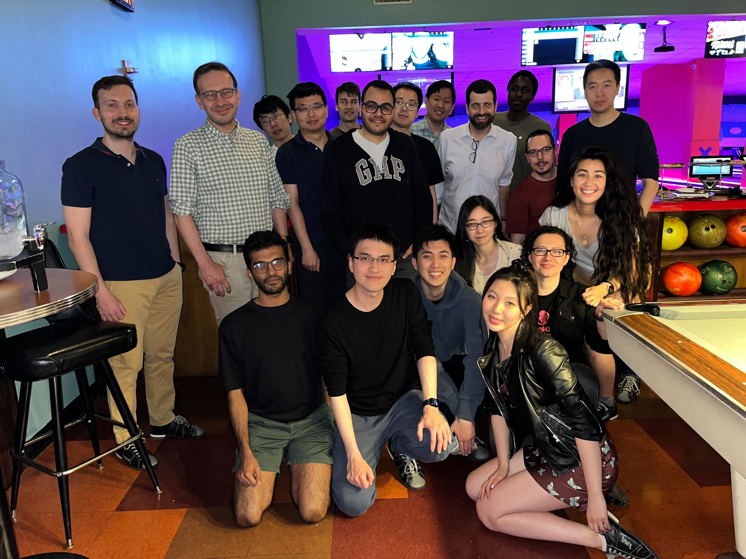

Acknowledgements (MIT DSG)

Slide 106
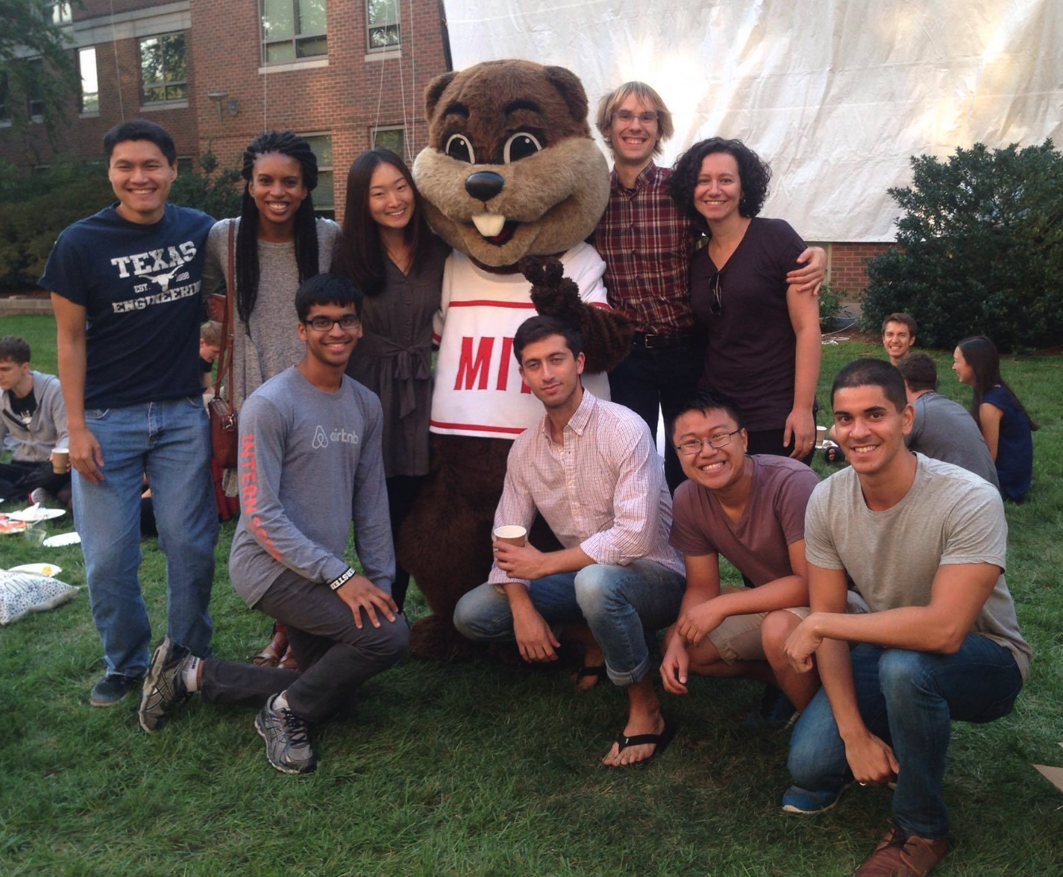
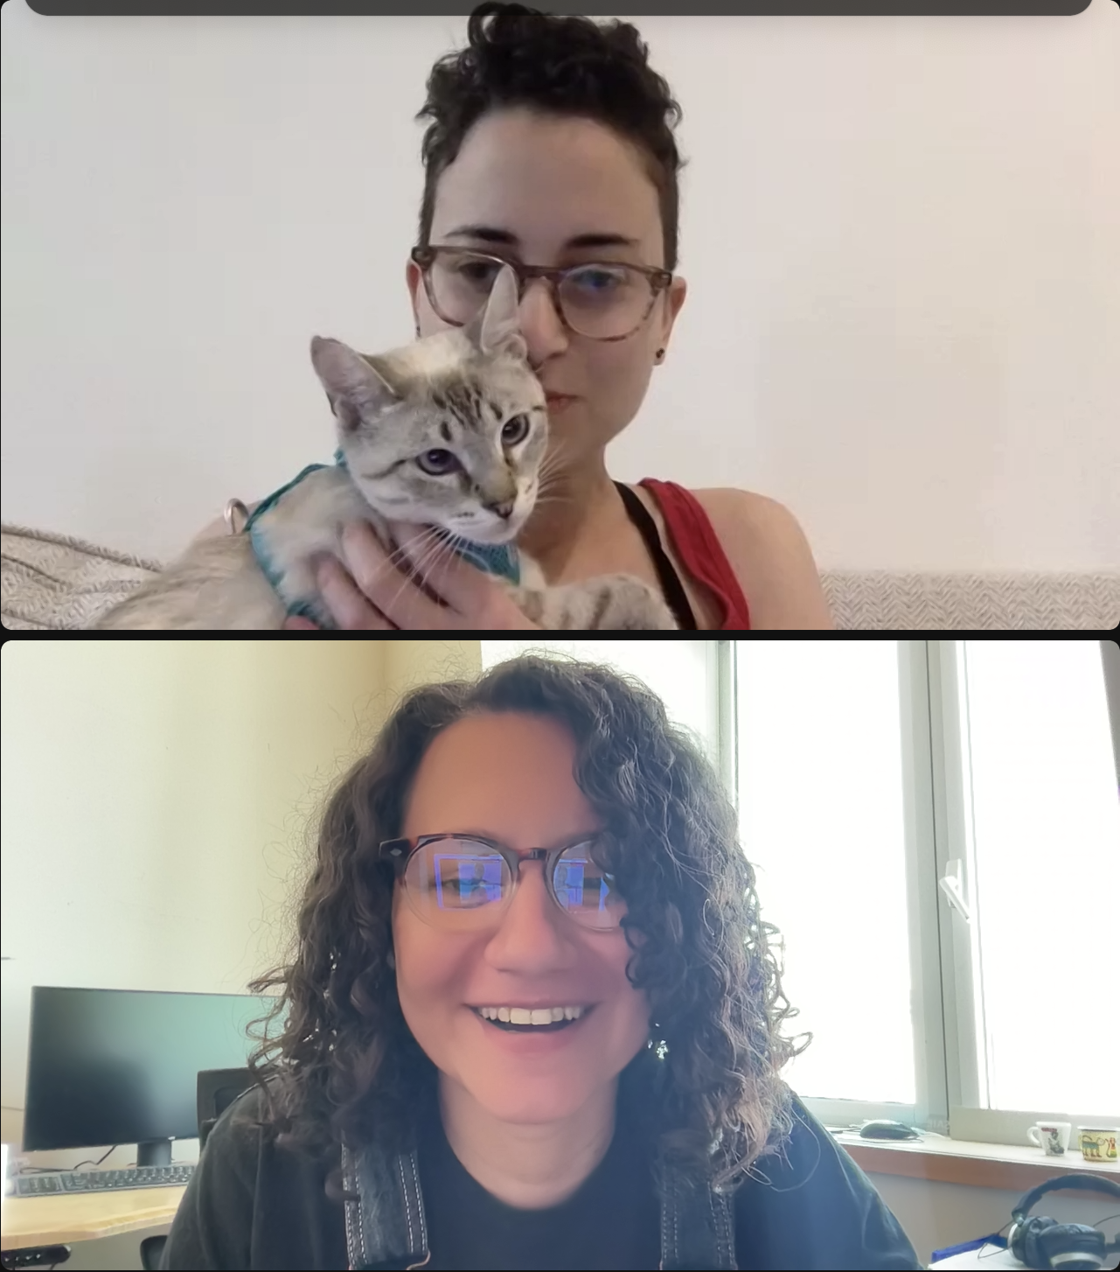
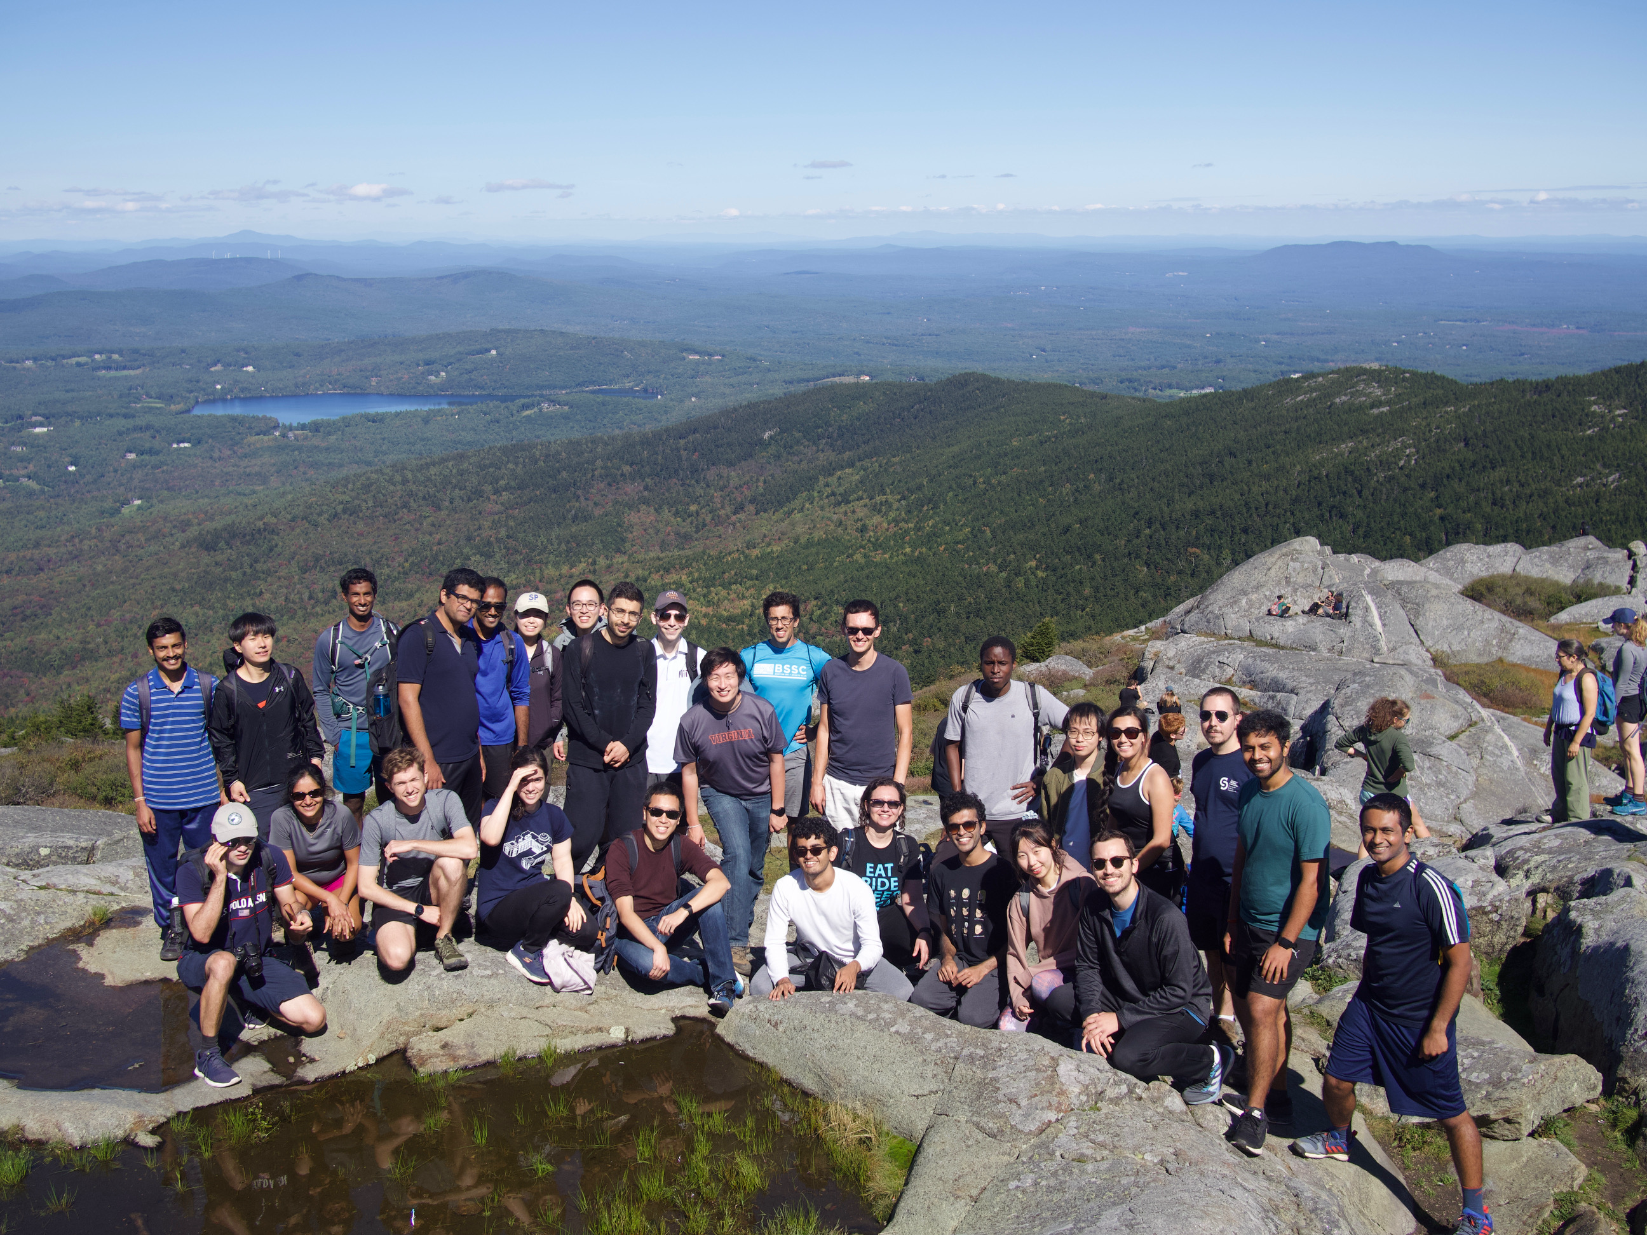

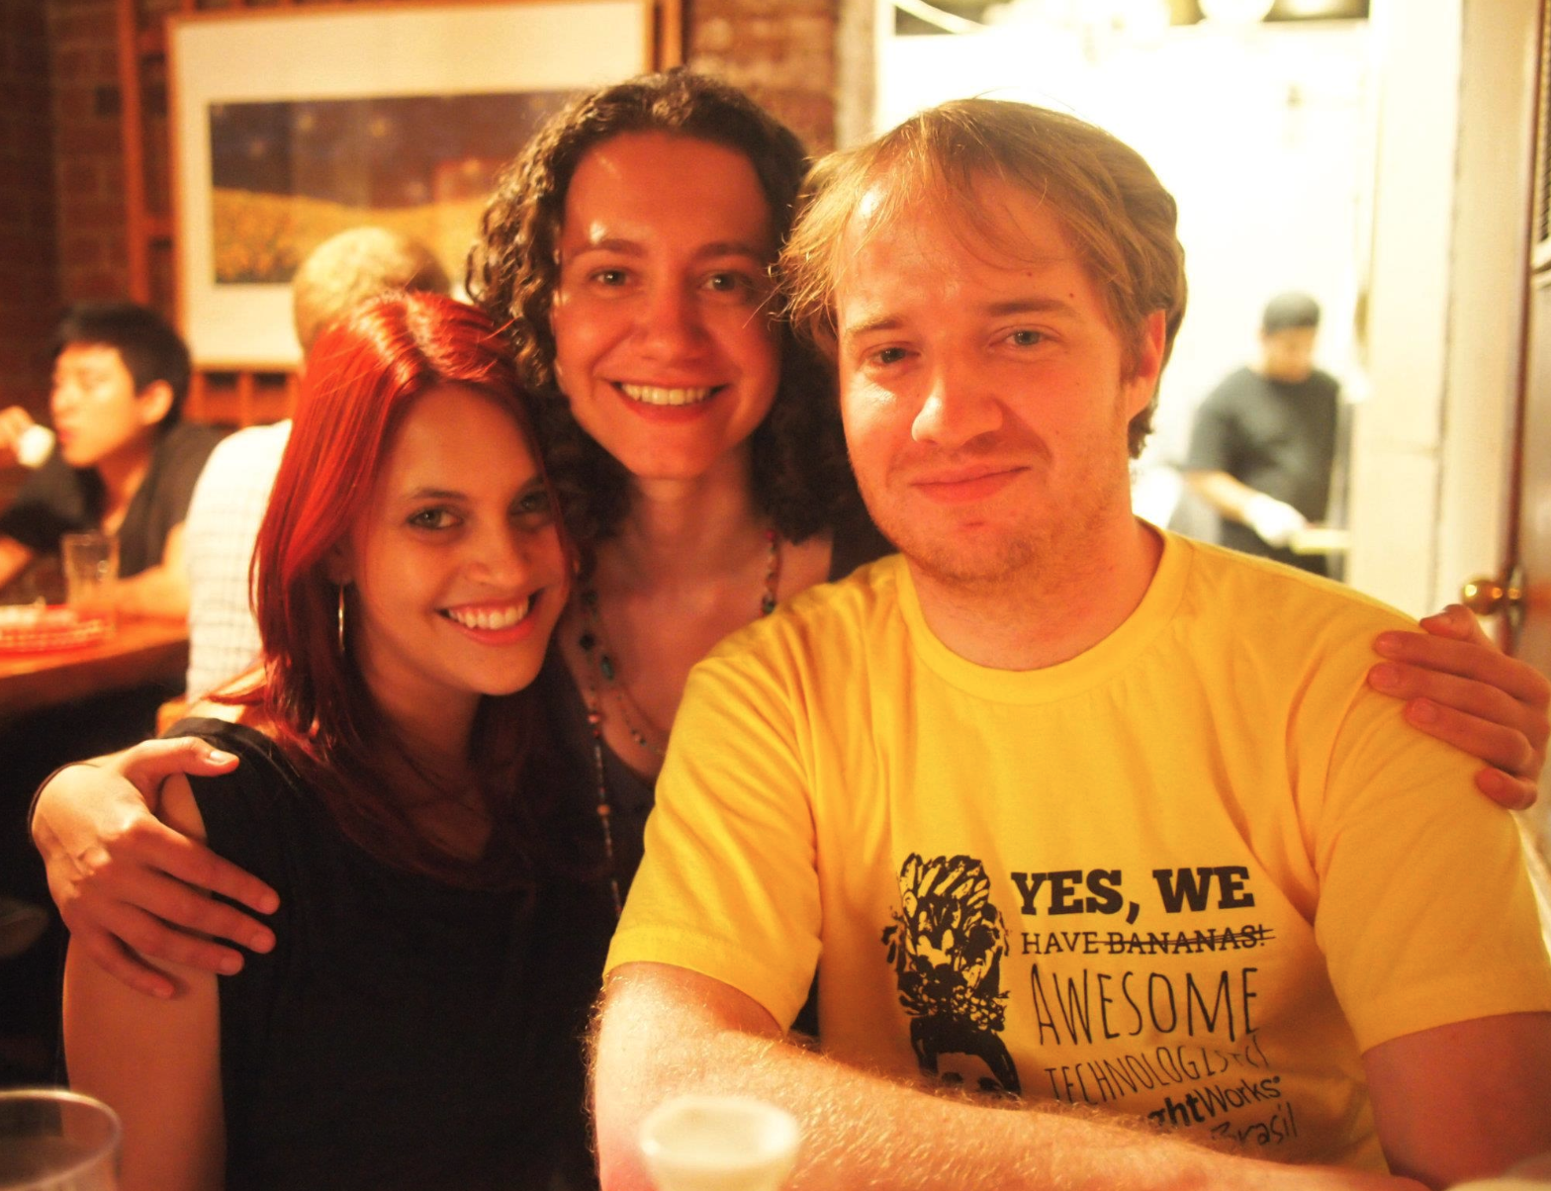
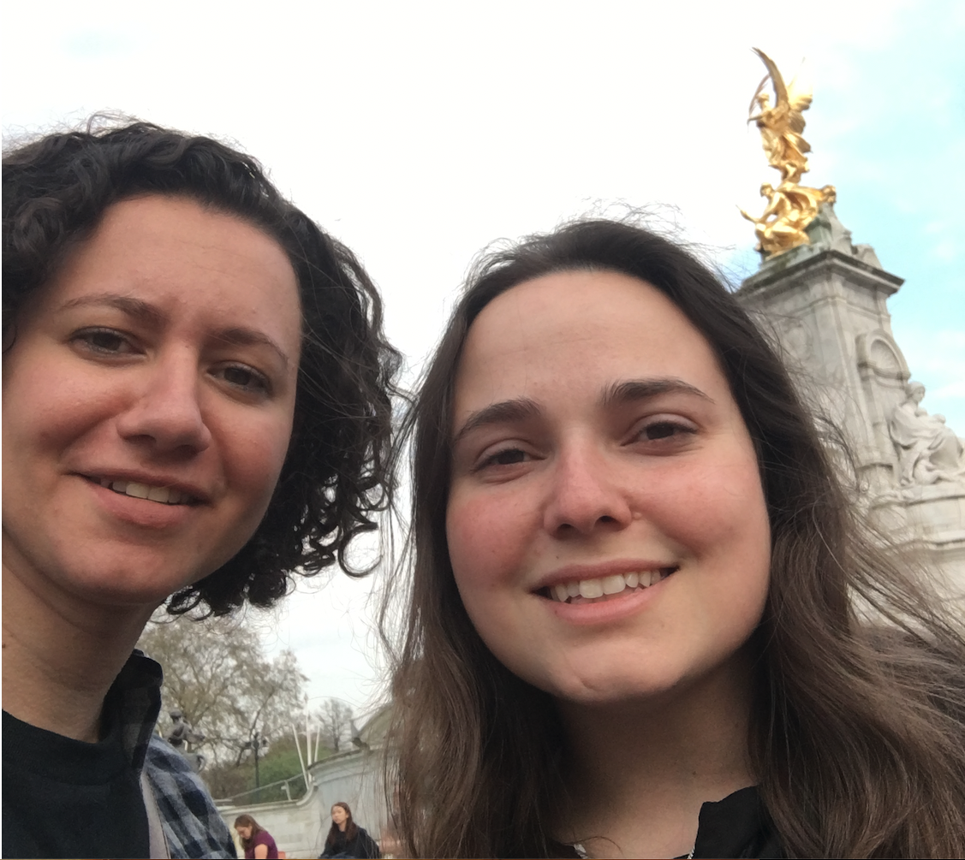
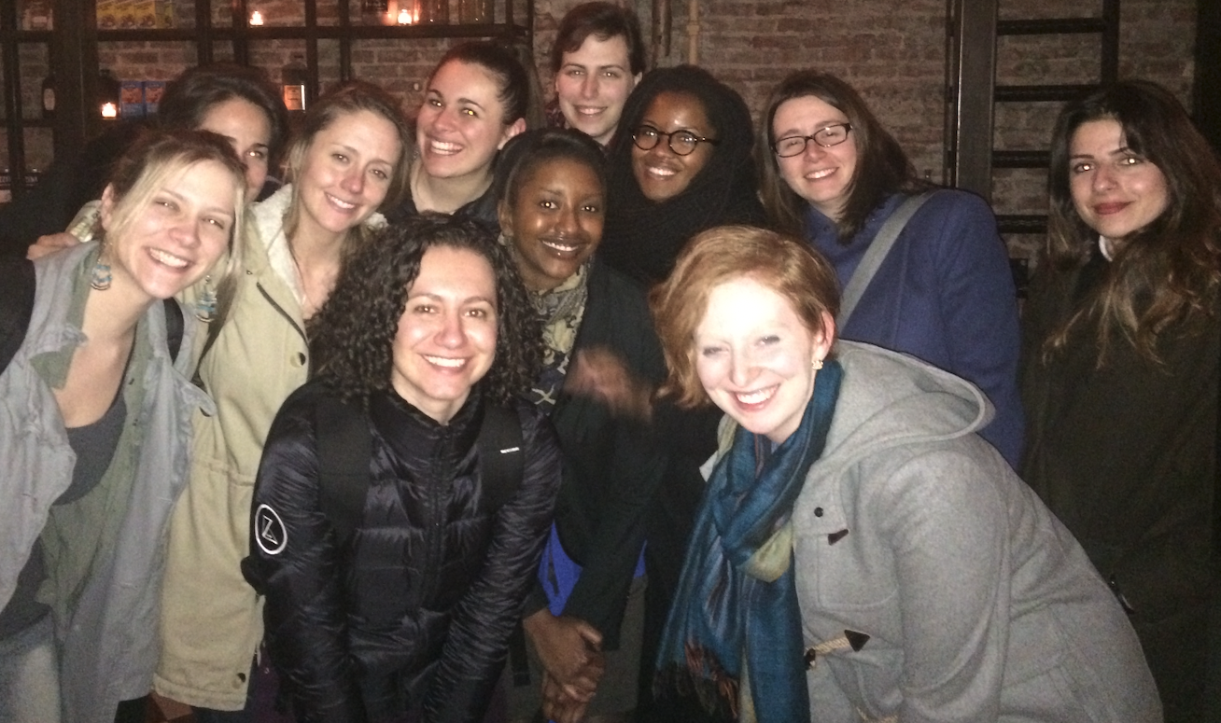
Acknowledgements (MIT + Friends)

Slide 107

Acknowledgements (Family)
Notes:
family is the one you choose (or the one that chooses you?) happy to have been “adopted” by Gabi’s ☺
love our furry kiddos so much. miss Christian ☹

Slide 108
THANK YOU!

Slide 109
K-hop path query example: Job “blast radius” over machine generated lineage graphs
Variable | Binding | Type
j1 | Job1 | Job
MATCH (j1:Job)->(f1:File)
(f1:File)-[r*0..k]->(f2:File)
(f2:File)->(j2:Job)
RETURN j1, j2
Notes:
Opencypher syntax; at the very end, give the actual bindings (e.g., the result of this query is job); put a ellipses in the table, the concrete results below what they are (make it explicit)
First, we define a graph pattern as a collection of vertices and edges. We’re saying, “hey, the source for this graph pattern is a vertex of type Job, it connects via an edge of type “WRITES_TO” to a vertex of type “FILE” ; that same vertex is anywhere from 0 to 8 hops away from another vertex of type FILE F2, Finally, f2 connects to a sink vertex of type “JOB” via a “IS_READ_BY” edge.

Slide 110
K-hop path query example: Job “blast radius” over machine generated lineage graphs
Variable | Binding | Type
j1 | Job1 | Job
f1 | File1 | File
MATCH (j1:Job)->(f1:File)
(f1:File)-[r*0..k]->(f2:File)
(f2:File)->(j2:Job)
RETURN j1, j2
Notes:
First, we define a graph pattern as a collection of vertices and edges. We’re saying, “hey, the source for this graph pattern is a vertex of type Job, it connects via an edge of type “WRITES_TO” to a vertex of type “FILE” ; that same vertex is anywhere from 0 to 8 hops away from another vertex of type FILE F2, Finally, f2 connects to a sink vertex of type “JOB” via a “IS_READ_BY” edge.

Slide 111
K-hop path query example: Job “blast radius” over machine generated lineage graphs
Variable | Binding | Type
j1 | Job1 | Job
f1 | File1 | File
f2 | File2 | File
MATCH (j1:Job)->(f1:File)
(f1:File)-[r*0..k]->(f2:File)
(f2:File)->(j2:Job)
RETURN j1, j2
Notes:
First, we define a graph pattern as a collection of vertices and edges. We’re saying, “hey, the source for this graph pattern is a vertex of type Job, it connects via an edge of type “WRITES_TO” to a vertex of type “FILE” ; that same vertex is anywhere from 0 to 8 hops away from another vertex of type FILE F2, Finally, f2 connects to a sink vertex of type “JOB” via a “IS_READ_BY” edge.

Slide 112
K-hop path query example: Job “blast radius” over machine generated lineage graphs
Variable | Binding | Type
j1 | Job1 | Job
f1 | File1 | File
f2 | File2 | File
j2 | Job2 | Job
MATCH (j1:Job)->(f1:File)
(f1:File)-[r*0..k]->(f2:File)
(f2:File)->(j2:Job)
RETURN j1, j2
Notes:
First, we define a graph pattern as a collection of vertices and edges. We’re saying, “hey, the source for this graph pattern is a vertex of type Job, it connects via an edge of type “WRITES_TO” to a vertex of type “FILE” ; that same vertex is anywhere from 0 to 8 hops away from another vertex of type FILE F2, Finally, f2 connects to a sink vertex of type “JOB” via a “IS_READ_BY” edge.

Slide 113
K-hop path query example: Job “blast radius” over machine generated lineage graphs
Variable | Binding | Type
j1 | Job1 | Job
f1 | File1 | File
f2 | File2 | File
j2 | Job2 | Job
… | … | …
j2 | JobX | Job
MATCH (j1:Job)->(f1:File)
(f1:File)-[r*0..k]->(f2:File)
(f2:File)->(j2:Job)
RETURN j1, j2
Pattern matches all jobs
up to k hops away
Notes:
POINT OUT THAT THE RESULT ITSELF IS A GRAPH
The paths in the graph explicitly follow a “producer-consumer” relationship, and what we’re trying to get here is all the dependency jobs in this sort of data-flow graph, that are in the forward data lineage from that source vertex Job1, and up to 10 hops away

Slide 114
Problem formulation: finding graph views as a satisfiability problem
Logical clause example (Prolog syntax):
path(X, Y) :- edge(X, Y).
path(X, Y) :- path(X, Z), path(Z, Y).
Facts extracted from input queries and schema are axioms (constraints).
edge(1, 2). edge(1, 3). edge(2, 4). edge(3, 4).
Graph view enumerators (templates) are encoded as logical clauses that are satisfiable iff view is feasible given input constraints.
A single template can enumerate multiple views, but only most beneficial are chosen, e.g., smaller in size, useful to more than one query, etc.

Slide 115
Constraint-based view enumeration: Query and schema fact extraction
Schema:
Explicit facts extracted from graph’s schema:
writes_to
schemaVertex('Job'). schemaVertex('File'). schemaEdge('Job', 'File', 'writes_to'). schemaEdge('File', 'Job', 'is_read_by').
Job
File
is_read_by
Explicit facts extracted from query’s graph pattern:
queryVertex(j1). queryVertexType(j1, 'Job').
queryVertex(f1). queryVertexType(f1, 'File').
queryVertex(f2). queryVertexType(f2, 'File').
queryVertex(j2). queryVertexType(j1, 'Job').
queryEdge(j1, f1).
queryEdgeType(j1, f1, 'writes_to').
queryEdge(f2, j2).
queryEdgeType(f2, j2, 'is_read_by'). queryVariableLengthPath(f1, f2, 0, 8).
Query:
MATCH
(j1:Job)-[:writes_to]->(f1:File)
(f1:File)-[r*0..8]->(f2:File)
(f2:File)-[:is_read_by]->(j2:Job)
RETURN j1, j2
Notes:
The trickier one is this special edge that the Cypher graph pattern query language supports. We have a specific predicate to encode that. It is kind of important, as you can enumerate multiple paths from this predicate.

Slide 116
Constraint-based view enumeration: Inferring view candidates
Each view template yields set of candidate views that are feasible given input schema and query constraints.
Explicit facts extracted from graph’s schema:
schemaVertex('Job'). schemaVertex('File').
schemaEdge('Job', 'File', 'writes_to').
schemaEdge('File', 'Job', 'is_read_by').
Feasible assignments for example view template
“kHopConnectorSameVertexType”:
Explicit facts extracted from query’s graph pattern:
(X='j1', Y='j2', XTYPE='Job', K=2)
(X='j1', Y='j2', XTYPE='Job', K=4)
(X='j1', Y='j2', XTYPE='Job', K=6)
(X='j1', Y='j2', XTYPE='Job', K=8)
(X='j1', Y='j2', XTYPE='Job', K=10)
queryVertex(j1). queryVertexType(j1, 'Job').
queryVertex(f1). queryVertexType(f1, 'File').
queryVertex(f2). queryVertexType(j1, 'File').
queryVertex(j2). queryVertexType(j1, 'Job').
queryEdge(j1, f1).
queryEdgeType(j1, f1, 'writes_to').
queryEdge(f2, j2).
queryEdgeType(f2, j2, 'is_read_by').
queryVariableLengthPath(f1, f2, 0, 8).
Notes:
The final step in that process is you get all the facts you extracted from the schema, as well as the graph pattern, and when you evaluate the specific view template here, you get a set of feasible view candidates. NOW NOT ALL view candidates will be materialized, which leads us to…

Slide 117
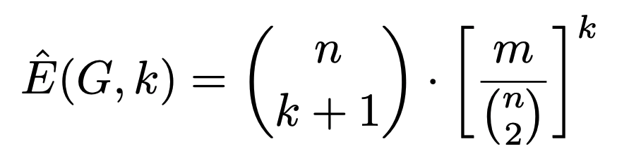
Cost Model for Graph Views: Structural Properties Guide View Size Estimation
Number of potential
k-length paths
Example: expected number of k-length simple paths in an Erdos-Renyi random graph
Notes:
Erdos-Renyi random graphs [28], where edges are generated uniformly at random, and the expected number of k-length simple paths can be computed as

Slide 118
Cost Model for Graph Views: Structural Properties Guide View Size Estimation
Probability that it
is an actual path
Example: expected number of k-length simple paths in an Erdos-Renyi random graph
Notes:
Erdos-Renyi random graphs [28], where edges are generated uniformly at random, and the expected number of k-length simple paths can be computed as…
Second inner-block is probability of a single edge.

Slide 119
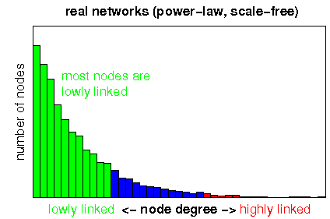
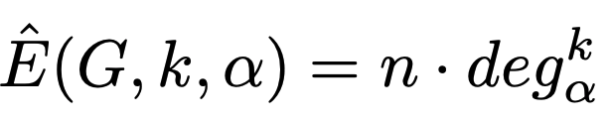
Cost Model for Graph Views: Structural Properties Guide View Size Estimation
Parameterized by percentile out-degree
Example: estimating number of directed
k-length paths in homogeneous graph
e.g., α = 50 (median)
Notes:
In practice, KASKADE relies on the estimator parameterized with α = 95 as it provides an upper bound for most real-world graphs that we have observed.

Slide 120
Cost Model for Graph Views: Structural Properties Guide View Size Estimation
Parameterized by percentile out-degree
Example: estimating number of directed
k-length paths in homogeneous graph
e.g., α = 95 (95th %ile)
Notes:
In practice, KASKADE relies on the estimator parameterized with α = 95 as it provides an upper bound for most real-world graphs that we have observed.

Slide 121
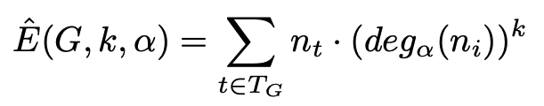
Cost Model for Graph Views: Structural Properties Guide View Size Estimation
Example: size estimator for k-hop connector views
Notes:
Feedback from practice talk: animate this slide to show from which facts the unification was drawn

Slide 122
Cost Model for Graph Views: Structural Properties Guide View Size Estimation
For each type of vertex
that can be an edge source
Example: size estimator for k-hop connector views
Notes:
Feedback from practice talk: animate this slide to show from which facts the unification was drawn

Slide 123
Cost Model for Graph Views: Structural Properties Guide View Size Estimation
How many vertices of that type do we have?
Example: size estimator for k-hop connector views
Notes:
Feedback from practice talk: animate this slide to show from which facts the unification was drawn

Slide 124
Cost Model for Graph Views: Structural Properties Guide View Size Estimation
Structural Property: out-degree percentile
Example: size estimator for k-hop connector views
Notes:
Feedback from practice talk: animate this slide to show from which facts the unification was drawn

Slide 125
Cost Model for Graph Views: Structural Properties Guide View Size Estimation
Number of likely
k-length paths in G
Example: size estimator for k-hop connector views
Notes:
Feedback from practice talk: animate this slide to show from which facts the unification was drawn

Slide 126
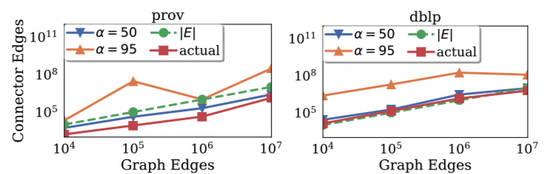


Cost Model: K-Hop Connector Size Estimator
We find that α = 95 provides a reasonable upper bound
Notes:
In practice, KASKADE relies on the estimator parameterized with α = 95 as it provides an upper bound for most real-world graphs that we have observed. Also note that the estimator with α = 95 for prov decreases when the original graph increases in size from 100K to 1M edges, increasing again at 10M edges. This is due to a decrease in the percentage of “job” vertices with a large out-degree, shifting the 95th percentile to a lower value. This percentile remains the same at 10M edges, while the 95th out-degree for “file” vertices increases at both 1M and 10M edges.

Slide 127


Datasets
Short Name | Type | No. Vertices | No. Edges
prov (raw) | Data lineage | 3.2 Billion | 16.4 Billion
prov (summarized) | Data lineage | 7 Million | 34 Million
dblp-net | Co-authorship | 5.1 Million | 24.7 Million
soc-livejournal | Social network | 4.8 Million | 68.9 Million
roadnet-usa | Road network | 23.9 Million | 28.8 Million
Notes:
- Data lineage graphs are sourced from Microsoft production cluster; all other graphs are publicly available
- With the exception of roadnet-usa, vertex degrees are exponentially distributed

Slide 128
Query Workload
Query | Operation Type | Result Type
Q1: Job Blast Radius | Retrieval | Subgraph
Q2: Ancestors | Retrieval | Set of Vertices
Q3: Descendants | Retrieval | Set of Vertices
Q4: Path lengths | Retrieval | Bag of scalars
Q5: Edge Count | Retrieval | Single scalar
Q6: Vertex Count | Retrieval | Single scalar
Q7: Community Detection | Update (property) | N/A
Q8: Largest Community | Retrieval | Subgraph
Notes:
Table lists the queries that we use in our evaluation of query runtimes. Queries Q1 through Q3 are motivated by telemetry use cases at Microsoft, and are defined as follows. The first query retrieves the job blast radius, up to 8 hops away, of all job vertices in the graph, together with their average CPU consumption property. Query Q2 retrieves the ancestors of a vertex (i.e., all vertices in its backward data lineage) up to 4 hops away, for all job vertices in the graph. Conversely, Q3 does the equivalent operation for forward data lineage for all vertices in the graph, also capped at 4 hops from the source vertex. Both Q2 and Q3 are also adapted for the other 3 graph datasets: on dblp, the source vertex type is “author” instead of “job”, and on homogeneous networks roadnet-usa and soc-livejournal all vertices are included.
Next, queries Q4 through Q7 capture graph operation primitives which are commonly required for tasks in dependency driven analytics. The first, query Q4 (“path lengths”), computes a weighted distance from a source vertex to all other vertices in its forward k-hop neighborhood, limited to 4 hops. It does so by first retrieving all vertices in a given vertex’s 4-hop neighborhood, and then for each vertex in this result set, it performs an aggregation operation (max) over a data property (edge timestamp) of all edges in the path. Queries Q5 and Q6 both measure the overall size of the graph (edge count and vertex count, respectively).
Finally, Q7 (“community detection”) and Q8 (“largest community”) are representative of common graph analytics tasks. The former runs a 25 passes iterative version of community detection algorithm via label-propagation, updating a community property on all vertices and edges in the graph, while Q8 uses the community label produced by Q7 to retrieve the largest community in terms of graph size as measured by number of vertices in each community. The label propagation algorithm used by Q7 is part of the APOC collection of graph algorithm UDFs for Neo4j [33].

Slide 129




Query runtimes for rewrites over summarizer and and over 2-hop connector views
Highly-structured graphs: virtually every query benefits from views
Notes:
This is a subset of the results we have in the paper. The two graphs at the top are highly-structured (only certain vertex types can connect to other vertex types, e.g., job and file on data lineage graph, author and paper on dblp graph). In this case, virtually every query benefits from running over a combination of summarizer and 2-hop connector graph views.

Slide 130
Query runtimes for rewrites over summarizer and and over 2-hop connector views
Less structured graphs: vertex-to-vertex connector is larger than original graph.
Notes:
What we mean here by less structured graphs: these are homogeneous networks, or in other words, they have only one type of vertex and one type of edge, so vertices can connect to any other vertex in the graph. So we expected the queries to be slower when answered in terms of those 2-hop connector views, given that these views should be larger (contain more edges) than the original graph.
---
Here we shows our results, with runtimes averaged over 10 runs, plotted in log scale on the y-axis. Because the amount of data required to answer the rewritten query is up to orders of magnitude smaller (§ VII-E) in the heterogeneous networks, virtually every query over the prov and dblp graphs benefit from executing over the connector view. Specifically, Q2 and Q3 have the least performance gains (less than 2 times faster), while Q4 and Q8 obtain the largest runtime speedups (13 and 50 times faster, respectively). This is expected: Q2 (“ancestors”) and Q3 (“descendants”) explore a k-hop ego-centric neighborhood in both the filtered graph and in the connector view that is of the same order of magnitude. Q4 (“path lengths”) and Q8 (“community detection”), on the other hand, are queries that directly benefit from the significant size reduction of the input graph. In particular, the maximum number of paths in a graph can be exponential on the number of vertices and edges, which affects both the count of path lengths that Q4 performs, as well as the label-propagation updates that Q8 requires. Finally, we also observe that because KASKADE creates connector views through graph transformations that are engine-agnostic, these gains should be available in other systems as well.
For the homogeneous networks, we look at the total query runtimes over the raw graph and over a vertex-to-vertex materialized 2-hop connector, which may be up to orders of magnitude larger than the raw graph (§ VII-D), as these networks have only one type of edge. Despite these differences in total sizes, a non-intuitive result is that the total query runtime is still linearly correlated with the order of magnitude increase in size for the network with a power-law degree distribution (soc-livejournal), while it decreases for path-related queries in the case of roadnet-usa. This is due to a combination of factors, including the larger fraction of long paths in roadnet-usa. Lastly, while the decision on which views to materialize heavily depends on the estimated view size (e.g., size budget constraints, and proxy for view creation cost), we note that these 2-hop connector views are unlikely to be materialized for the two homogeneous networks, due to the large view sizes predicted by our cost model as we see in the size estimation experiments.

Slide 131
Query runtimes for rewrites over summarizer and and over 2-hop connector views
Non-intuitive result due to
larger fraction of long paths in road network.
Notes:
However, a non-intuitive result, is that path-related queries in the road network still benefitted from the 2-hop connector view. One of the reasons for that is that the road-network had a much larger fraction of long paths than the social network.
---
Here we shows our results, with runtimes averaged over 10 runs, plotted in log scale on the y-axis. Because the amount of data required to answer the rewritten query is up to orders of magnitude smaller (§ VII-E) in the heterogeneous networks, virtually every query over the prov and dblp graphs benefit from executing over the connector view. Specifically, Q2 and Q3 have the least performance gains (less than 2 times faster), while Q4 and Q8 obtain the largest runtime speedups (13 and 50 times faster, respectively). This is expected: Q2 (“ancestors”) and Q3 (“descendants”) explore a k-hop ego-centric neighborhood in both the filtered graph and in the connector view that is of the same order of magnitude. Q4 (“path lengths”) and Q8 (“community detection”), on the other hand, are queries that directly benefit from the significant size reduction of the input graph. In particular, the maximum number of paths in a graph can be exponential on the number of vertices and edges, which affects both the count of path lengths that Q4 performs, as well as the label-propagation updates that Q8 requires. Finally, we also observe that because KASKADE creates connector views through graph transformations that are engine-agnostic, these gains should be available in other systems as well.
For the homogeneous networks, we look at the total query runtimes over the raw graph and over a vertex-to-vertex materialized 2-hop connector, which may be up to orders of magnitude larger than the raw graph (§ VII-D), as these networks have only one type of edge. Despite these differences in total sizes, a non-intuitive result is that the total query runtime is still linearly correlated with the order of magnitude increase in size for the network with a power-law degree distribution (soc-livejournal), while it decreases for path-related queries in the case of roadnet-usa. This is due to a combination of factors, including the larger fraction of long paths in roadnet-usa. Lastly, while the decision on which views to materialize heavily depends on the estimated view size (e.g., size budget constraints, and proxy for view creation cost), we note that these 2-hop connector views are unlikely to be materialized for the two homogeneous networks, due to the large view sizes predicted by our cost model as we see in the size estimation experiments.

Slide 132

K-hop path query example: Job “blast radius” over machine generated lineage graphs
System Admin
“Which jobs may be impacted by Job1?”
Several incident response use cases (e.g., identifying privacy violations)
in datacenters consist of answering k-hop path queries.
R. Mavlyutov et al, Dependency-Driven Analytics: A Compass for Uncharted Data Oceans. CIDR 2017
Notes:
To recap: analyzing these data lineage graphs turns out to be important for number of operational decisions in datacenters. Users such as system administrators, site reliability engineers, or even automated processes constantly monitor these graphs for a number of reasons, which include incident response or policy violations. Suppose I discover a result in file 1, which was inadvertently leaked, I may then need to figure out all downstream jobs of that file.
These kinds of graph k-hop path queries occur in other domains as well. For example, disease propagation networks, such as those used for COVID-19 contact tracing. In those graphs, the ”disease infection” is what gets propagated across the network. Given that you know a vertex has been infected, you’d like to know what other vertices have been infected within a fixed mile radius. In fact, we experimented with several different graphs and queries like this in our experiments.

Slide 133


Real-world graphs are skewed (degree distr.)
Sample from Microsoft prod cluster data lineage graph: each CC is a pipeline
Notes:
Examples of skew include exponentially distributed degrees, and exponentially distributed inter-arrival times (e.g., interaction networks, and other human generated processes_

Slide 134

Real-world graphs are skewed (degree distr.)
90th %ile CC size is orders of magnitude smaller than largest CC
e.g., a single job produced output
consumed by almost all pipelines
(X axis values omitted)
Sample from Microsoft prod cluster data lineage graph: each CC is a pipeline
Notes:
Examples of skew include exponentially distributed degrees, and exponentially distributed inter-arrival times (e.g., interaction networks, and other human generated processes_

Slide 135

Real-world graphs are skewed (duration & iat)
Trip start time: [8am, 8:05am]
CitiBike NYC trips data available at https://citibikenyc.com/system-data
Notes:
Examples of skew include exponentially distributed degrees, and exponentially distributed inter-arrival times (e.g., interaction networks, and other human generated processes). In fact, inter-arrival times for many human generated processes is log-normally distributed, or in other words, yields some form a power-law.

Slide 136

Why do we care about temporal graphs? Certain questions answered incorrectly without time info
Direction is incorrect if edge start time is missing.
False positives / negatives if edge duration is missing.
M. Johannes and M. Kretzschmar, Forward thinking on backward tracing. Nature Physics 2021
Notes:
These kinds of graph k-hop path queries occur in other domains as well. For example, disease propagation networks, such as those used for COVID-19 contact tracing. In those graphs, the the ”disease infection” is what gets propagated across the network. Given that you know a vertex has been infected, you’d like to know what other vertices have been infected within a fixed mile radius. In fact, we experimented with several different graphs and queries like this in our experiments.

Slide 137
Is TGER sufficient for retrieving vertex’s neighbors in all temporal walks of interest?

